Slide 1
Humanimal Trust and One Medicine
Registered Charity No.s 1156927 & SC048960

Slide 2
One Health and One Medicine
The two concepts are inter-related and share a common denominator i.e. closer alignment and greater collaboration between human and veterinary medicine.​
However, the two terms are distinct from one another and are synergistic rather than synonymous with each other.​
One Health (in its present form since the early 2000s) is defined by the World Organisation for Animal Health (OIE) as follows: “Human health and animal health are interdependent and bound to the health of the ecosystems in which they exist.”​
The foundations of One Health lie in a much older concept called One Medicine. One Medicine does not seek to undermine the more well-known One Health concept, but goes beyond in its scope.
Ref: OIE (2021) https://www.oie.int/en/for-the-media/onehealth/

Slide 3
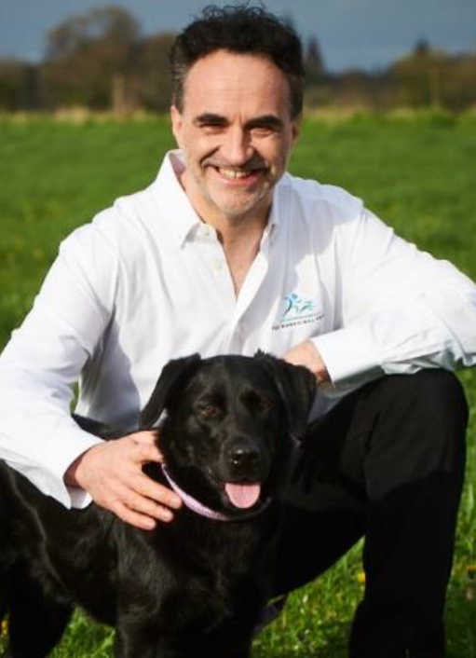
Humanimal Trust: Origins
Founded on 6 May 2014 by Professor Noel Fitzpatrick
As a veterinarian, he experienced the deep divide between human and animal medicine and saw how unfair this was.
Frustrated by the lack of opportunities to share what he was learning from day to day practice, or to benefit from relevant learning from human medicine, he decided to create the platform himself.

Slide 4
One Medicine
At Humanimal Trust, we believe that the world would be fairer and more respectful for humans and animals if One Medicine were more widely understood and delivered.
“I have always believed that it is only in looking after animals we will look after ourselves and that the medical professions, both veterinary and human, must unite in the guise of One Medicine”
Professor Noel Fitzpatrick

Slide 5
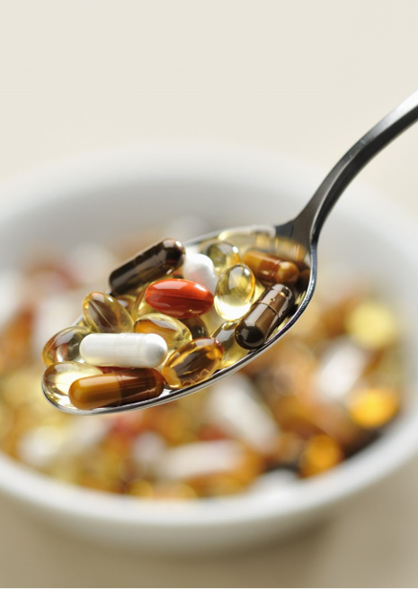
What is One Medicine?
Humanimal Trust drives collaboration between vets, doctors​ and researchers so that all humans and animals benefit from equal and sustainable medical progress, ​but not at the expense of an animal’s life.​​
​
This is One Medicine.​​
​

Slide 6
We need to do something - NOW
If we don’t act swiftly, we will all pay the price in wasted time, money and lives of both humans and animals.

Slide 7
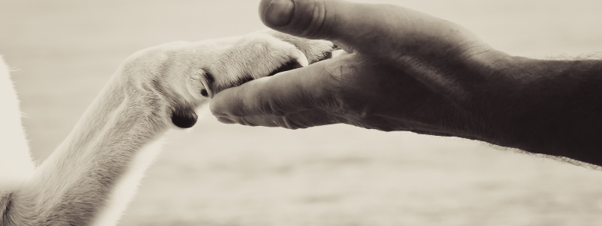
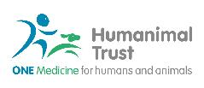
At Humanimal Trust, we believe that:
Human and animal healthcare can and should advance hand in hand.​
A two-way street between human and veterinary medicine is both possible and necessary for humans and animals to benefit equitably from cutting edge advances.

Slide 8
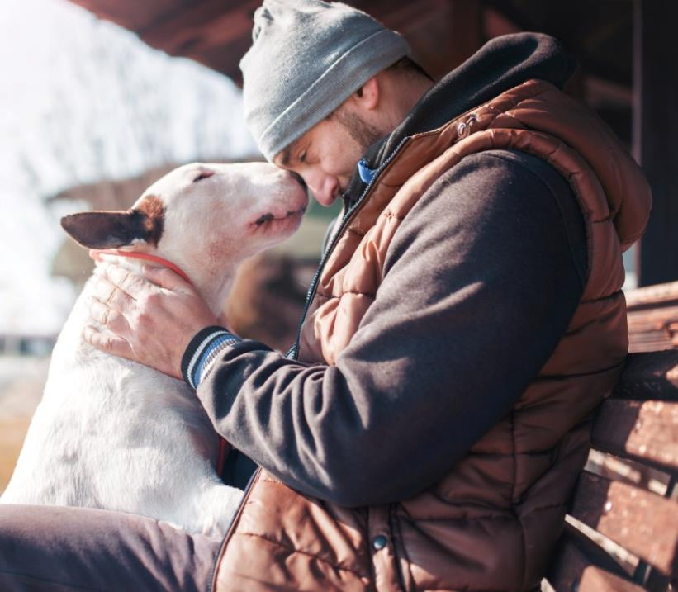
The benefits of a One Medicine approach
Advances in human and animal medicine can be achieved more quickly with closer collaboration and mutual learning.
We believe this will lead to fewer laboratory animal tests - until one day they become obsolete.
We all share responsibility for creating a fairer society, with better opportunities to benefit equally from medical progress for humans and animals.

Slide 9
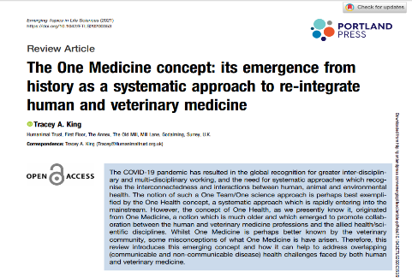

Slide 10
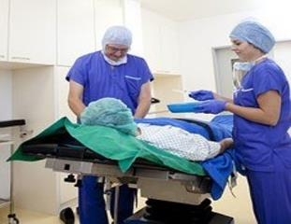
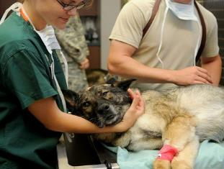
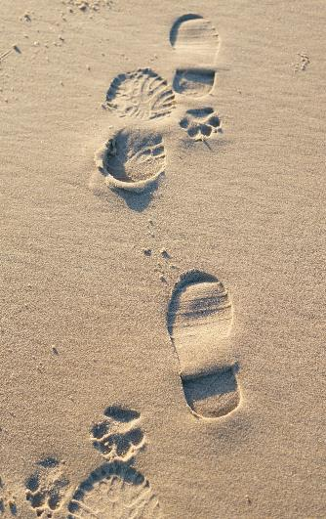
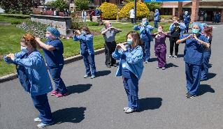
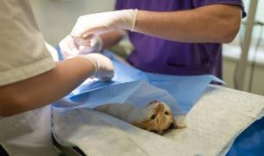
Can human and veterinary medicine ever be equitable?
In 2018, there were 242,433 GMC licensed doctors
Compared to 24,413 RCVS practicing veterinary surgeons in the UK in the same year
The footprint of human medicine is much bigger than veterinary medicine
At the end of March 2018, there were 646,637 human medical registered nurses
Compared to 15,782 RCVS registered veterinary nurses in 2018

Slide 11
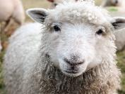
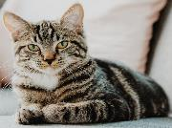
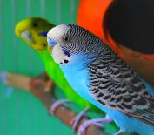
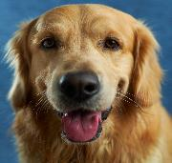
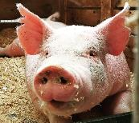
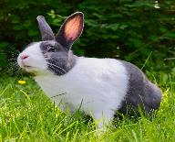
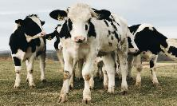
UK human and animal populations (2018)
In 2018, the total combined companion animal population + livestock animals (cattle, sheep and pigs) in the UK was 88 million.
At mid-2018, the UK human population was 66 million.
Date sources used:
RCVS Facts 2018
General Medical Council Data Explorer 2018
Pet Food Manufacturing Association, Pet Population Statistics 2018
Farming Statistics: Livestock populations at 1 December 2018, Defra
Statistical overview of the UK population: January 2021, ONS

Slide 12
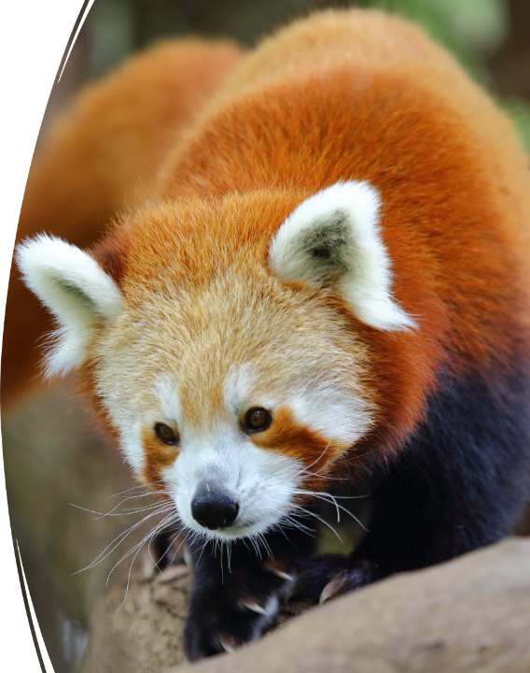
Zoonotic Diseases
Over 60% of all known infectious diseases are shared between humans and animals
World Health Organisation (WHO)

Slide 13
Zoonotic Diseases
Rabies
Ringworm
Various strains of Flu (Avian, Swine)
MRSA
Campylobacter
Salmonella
E. coli
Various strains of Tuberculosis
Leptospirosis
Lyme Disease
Giardia

Slide 14
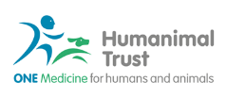
Zoonotic Diseases
75% of all emerging infectious diseases are shared between humans and animals.
UN report

Slide 15
I CARE – our charitable activities
What does this mean?
Influence
Collaboration
Awareness
Research
Education

Slide 16
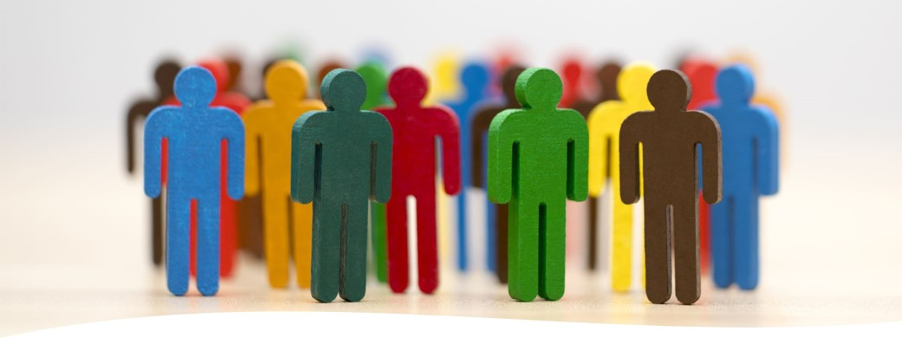
Influence
We work at all levels to influence people, driving positive change for humans and animals – informing people of the benefits of a One Medicine approach.
Legislators
Public opinion
Policy makers

Slide 17
Collaboration
Humanimal Hub
Collaboration Café
One Medicine Day – 6th May

Slide 18
Awareness
Talks and Presentations
Humanimal Connection Podcasts
Community Groups and Public Events
Medical and Veterinary Student and Professional Events

Slide 19
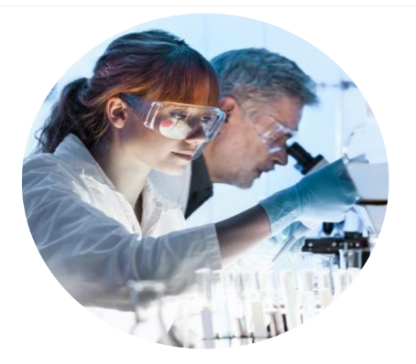
Research: What do we fund?
Small Awards and Prizes
Proof of Concept studies (up to £5K)
Medium sized projects (up to £25K)
PhD studentships
Humanimal Trust does NOT fund any research which involves the use of experimental animal models

Slide 20
Our 5 flagships areas for a One Medicine approach
Infection control & antimicrobial resistance
Cancer
Brain and spine disease
Bone, muscle & joint disease
Regenerative medicine

Slide 21
Research
Humanimal Trust only funds research using patients with naturally occurring disease:
No laboratory or experimental animal testing is funded.
Data and samples from real patients needing/receiving treatment is utilised.

Slide 22
Research
Project collaboration with Action Medical Research
Two projects:
Preventing infections and reducing the risk of antibiotic-resistant infections in critically ill children
Juvenile idiopathic arthritis – personalising drug treatment
Further reading: https://www.humanimaltrust.org.uk/what-we-do/research/small-project-awards/supporting-research-potential-help-children-and-animals

Slide 23
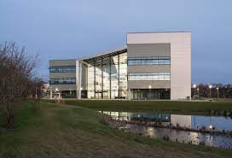
Previously funded research projects
Bacteriophages as an alternative to antibiotics (PhD studentship)
Dr Lucy Grist – recipient of first Humanimal Trust PhD studentship
Investigated the ability of phages to target and kill strains of Escherichia coli which had caused infections in canine patients

Slide 24
Education
Inspire and educate human and veterinary health professionals and those of the future and the public:
Schools
Sixth Form Colleges
Universities
CPD opportunities

Slide 25
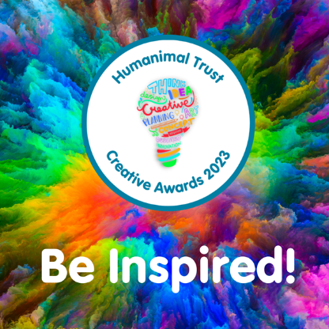
Creative Awards
Our first Creative Awards took place in 2023
Entries could be anything from a short story or poem to artwork, photography or video.
Prizes included online shopping vouchers and books, and the winning entries featured on Humanimal Trust’s website.
Keep an eye out for the next Creative Awards!

Slide 26
What is happening now?
In Podcast series 1, episode 1 we spoke with Dr Johan Marias of Save the Survivors.
They provide veterinary treatment and care for wildlife, especially rhinos who have been de-horned and shot by poachers.
They have learnt from human medics, especially about gunshot wounds, how to treat these endangered animals.
In 2008, the number of white rhinos in Kruger National Park was 10,500 and in 2019 there was a mere 3,500.
Collaboration has made them #StrongerTogether

Slide 27
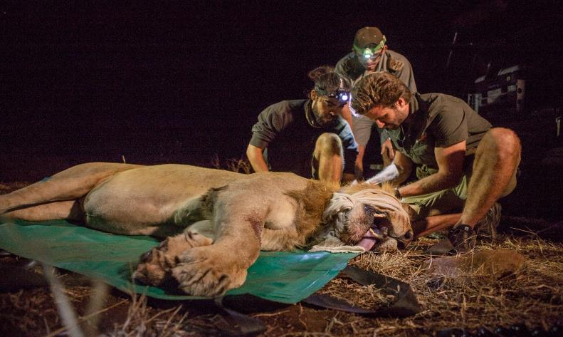
Out in the field

Slide 28
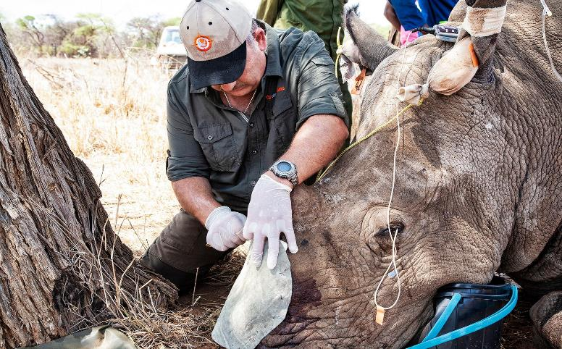
Skin graft

Slide 29
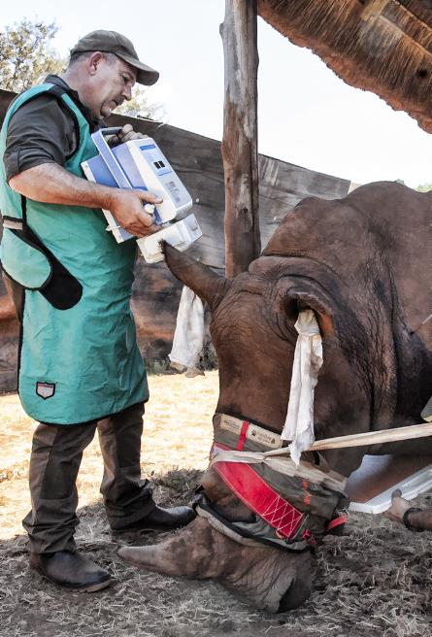
One Medicine in practice
Humanimal Trust podcasts
#StrongerTogether

Slide 30
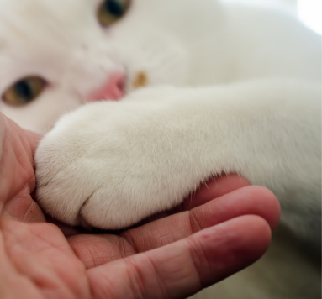
One Medicine for humans and animals
A credible vision of hope
YOU can help us make it happen!

Slide 31
One Medicine for humans and animals
Pause for a moment
With a partner, I want you to consider one of the illnesses that you can envisage One Medicine benefitting in the future. Maybe choose one we have mentioned today.
What do you see happening?
How will humans and animals benefit?
How are you part of this change?

Slide 32
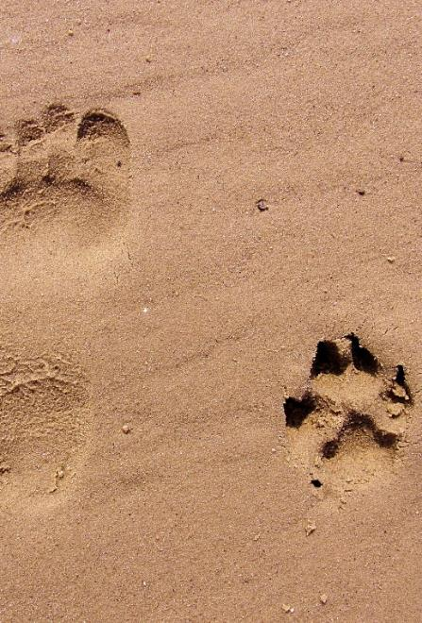
The world we want to see in the future…
Human and Animal health have demonstrably improved as a result of One Medicine
One Medicine is widely understood and embraced
Collaboration between human and animal medicine is the norm
There is sufficient funding and robust public policy to support collaboration between human and animal medicine
There is no scientific need and no legal requirement for laboratory animal testing

