Slide 1
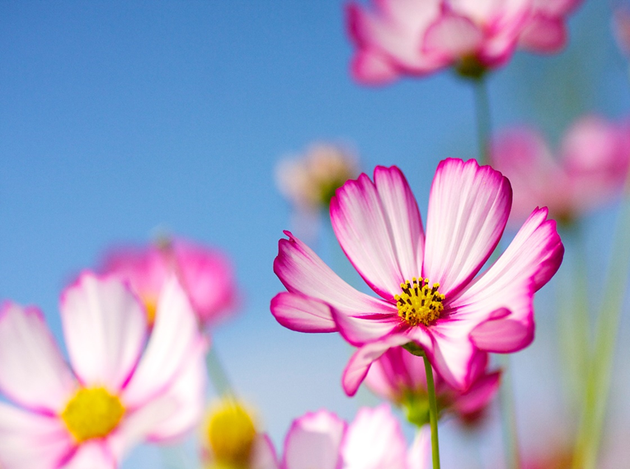
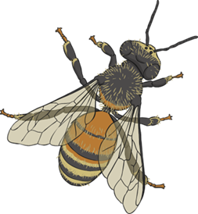

Bees

Slide 2

What do you know about Bees?
Do you know how important bees are to
us?
It is estimated that a third of all the food we eat each day comes because of pollination from bees and other insects.
Pollination is when pollen from flowering plants is taken to other plants so that seeds (and therefore new plants) can grow. For many different reasons, around one in ten of Europe’s native bee population is in danger of extinction.

Slide 3
What do you know about Bees?
Do you know how many species of bees there
are?
20,000 species of bee live around the world, with over 250 species in the UK.
Not all bees produce honey: solitary bees - as their name suggests - like to live on their own, or in small groups, they don't have a queen, or live in hives.

Slide 4
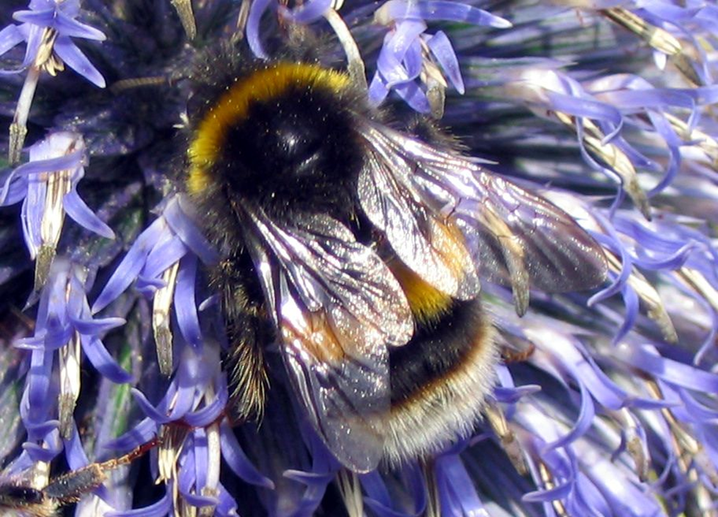
Species of bees
The Bumblebee

Slide 5
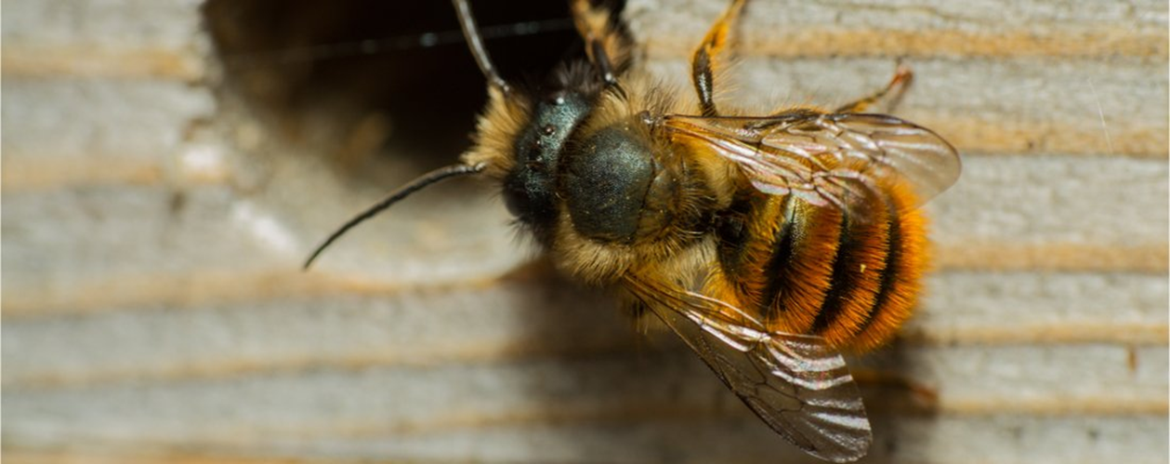
Species of bees
The Mason Bee
Picture from beelife.org

Slide 6
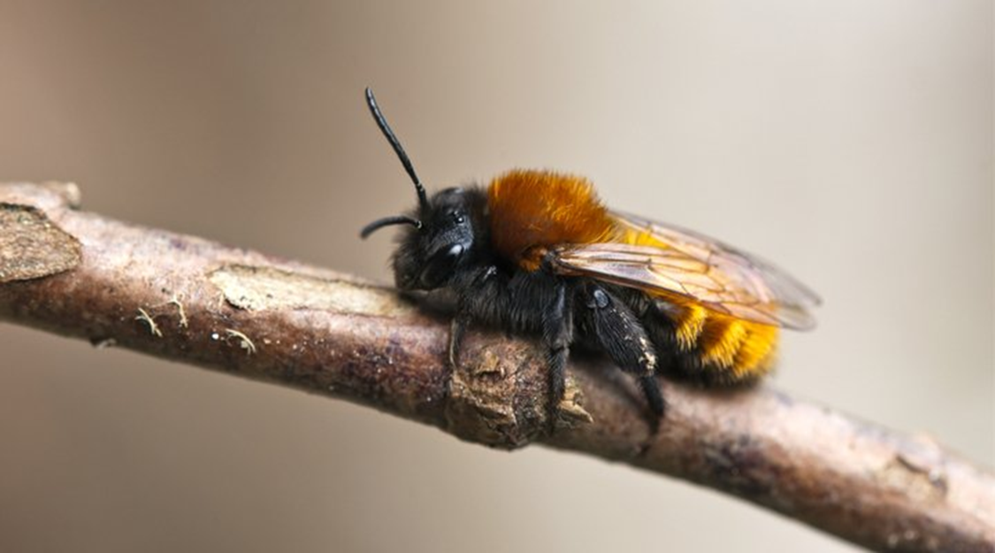
Species of bees
The Mining Bee
Picture from beelife.org

Slide 7
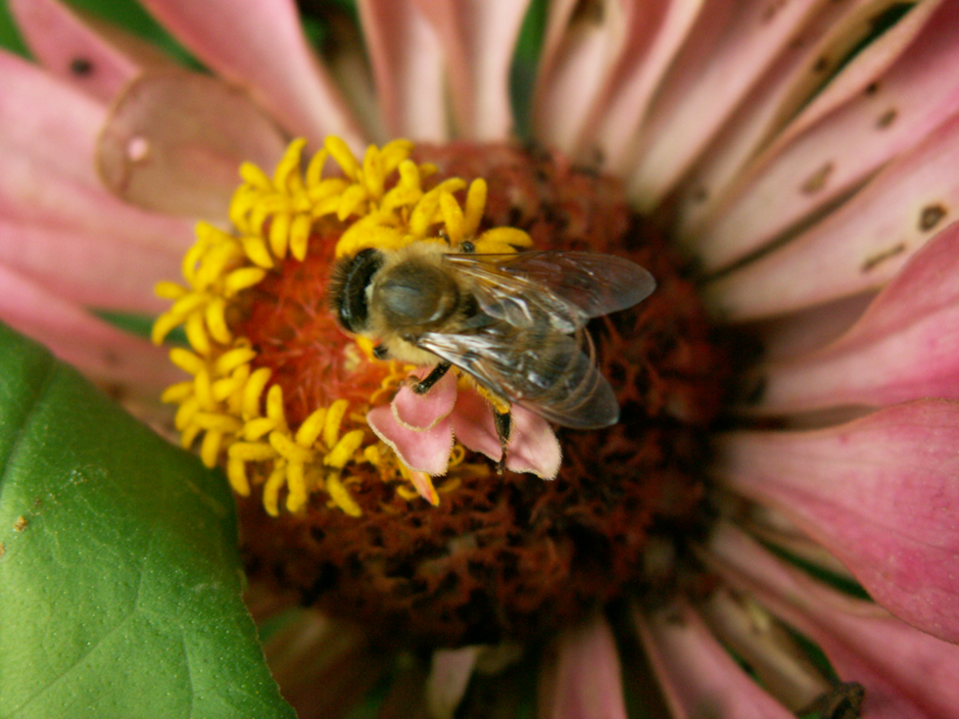
Species of bees
The Honeybee

Slide 8

Honeybee anatomy
Can you name the parts of the bee?
1
2
6
3
4
5
7
Notes:
Antennas
Mandible
Eye
Body parts
Wings
Legs
sting
3

Slide 9
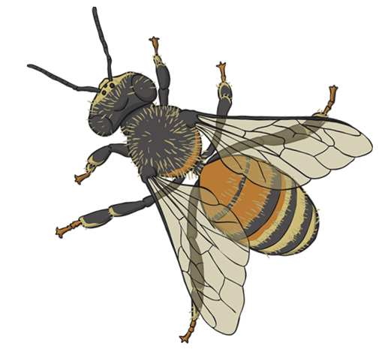
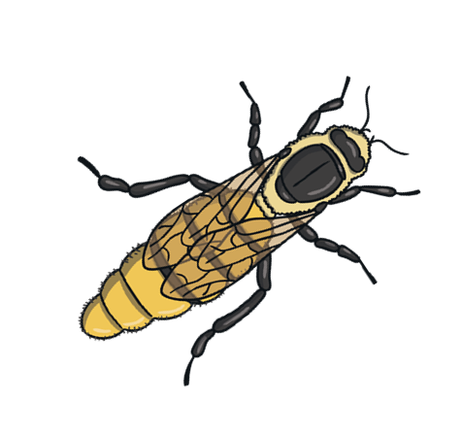
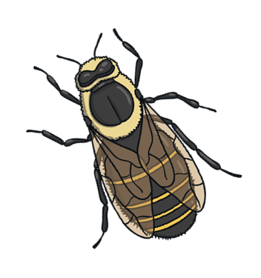
How do Honeybees communicate?

Slide 10
How do Honeybees communicate?
Honeybees, have a complex system of communication – just like us.
They may not use words, but they dance.
This dance is used by bees to teach each other about the direction and location of food sources over 6 kilometres away and it was discovered by an Austrian scientist called Karl von Frisch.
The bees perform precise movements to tell other bees in the hive exactly where they have found their new fantastic food source! Watch the video below to see what the incredible buzzing boogie looks like!

Slide 11
How do Honeybees communicate?
University of Gloucestershire The Waggle Dance

Slide 12
Why else do Honeybees communicate?
Did you know….
Bees vote!
Every spring, healthy honeybee hives that have become crowded divide into two. A daughter queen stays in the old nest and the rest of the bees start a new hive.
Before they can move though, they have to figure out where to build the new hive. This is how they do this….

Slide 13
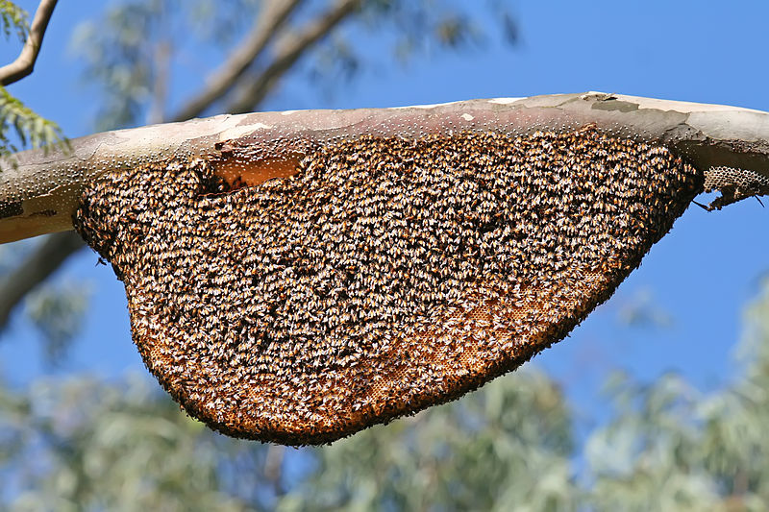
Hive of the giant honey bee in Bangalore, India
Photo courtesy of Muhammad Mahdi Karim

Slide 14
Some bee facts
£690 million is the mind-boggling amount that insect pollination is worth to UK crops each year. 76% of globally important commercial crops depend on insect pollination
Bee numbers are falling all over the world. This is due to habitat loss - 97% of wildflower meadows have been lost between 1930 and 1980- excessive use of pesticides and fewer flowers in towns and cities. There is also a mite called the varroa mite which attacks bees.
There are around 75% more wild bees on organic farms - organic farming can improve the numbers of bees found in habitats surrounding the farm. This is because organic farmers use fewer pesticides, and have a higher amount of bee-friendly habitats, like wildflower margins.
But, bees can bounce back! Bees are really responsive to changes in their habitat - for every 10% increase in bee-friendly habitats, like those found on organic farms, bee numbers and diversity increases by over a third! In organic grain fields, you can find up to 7 times more bees!

Slide 15
What can you do?
Create a buzz in your garden by planting bee friendly flowers,
Such as: common poppy, evergreen clematis, nasturtium or teasel.
Plant a bee friendly herb. These are not only great for us to use in our cooking, but give bees a great meal too. Bronze fennel, green coriander seed, chive flowers, lemon thyme and basil (Basil is great for on your pizza too!)
Create a bee hotel for solitary bees. You can buy these, but it is much more fun to make one. Here are one or two places to
Woodland Trust
Natural History Museum, is an easy version to make. https://www.nhm.ac.uk/
Royal Horticultural Society: https://www.rhs.org.uk/

Slide 16
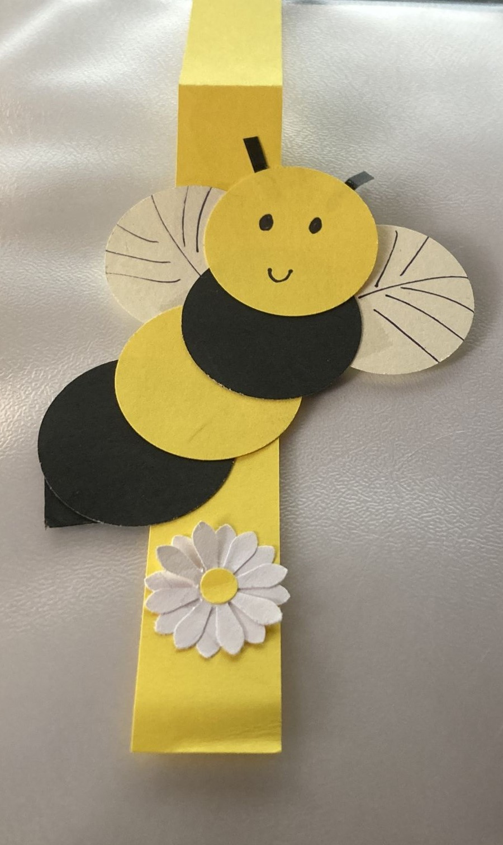
Bee creative!
As a reminder about how wonderful our buzzing friends are, you are each going to make your own bee bookmark.

Slide 17
Bee creative!
Take all the parts out of the envelope
Place them on the table in front of you
Decide if you want the daisy at the top or bottom of your bookmark.
Take the stinger body part and stick that on the bookmark first.
Next stick on the yellow thorax and the wings just above it.
Stick on the second black body section.
Draw a face on your bee and stick his antaennae on the back of the head.
Stick the head on last.
You could write on your bookmark what you want to do to help bees.

Slide 18
Show me your bees ☺
I hope you have enjoyed yourselves.
Any questions?

