Slide 1


Humanimal Trust and
One Medicine
Let’s raise some money and have some fun!
Registered Charity No.s 1156927 & SC048960

Slide 2

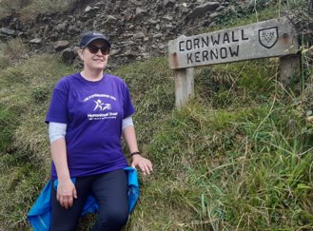


Fundraise for Us​
Challenge Events
Sponsored Activities ​
and Fundraising Events
Paws for a Picnic

Slide 3


More Ideas!
Teddy Bears Picnic
Dress up day – fancy dressing up as your favourite animal?
Have a stall at your school fair
Sponsored cake sale
Sponsored spell
Paws for a Picnic – recipes, masks and colouring in activities can be found here:
https://www.humanimaltrust.org.uk/get-involved/icare-campaign/paws-picnic-and-raise-funds-one-medicine/
paws-picnic-recipes-and
Do you fancy a challenge? What would you like to do?

Slide 4
With your help One Medicine will…
Save time
Save money
Save Lives
Notes:
VERY KEY SLIDE!!!!

Slide 5




Thank you!
www.humanimaltrust.org.uk
Find us on:
Notes:
Thank you very much for your time – and please do ask any questions.
If I’m unable to answer them today I’ll pass them on and we’ll come back to you as soon as possible.

