Slide 1
Comparative Anatomy and
One Medicine
Registered Charity No.s 1156927 & SC048960

Slide 2
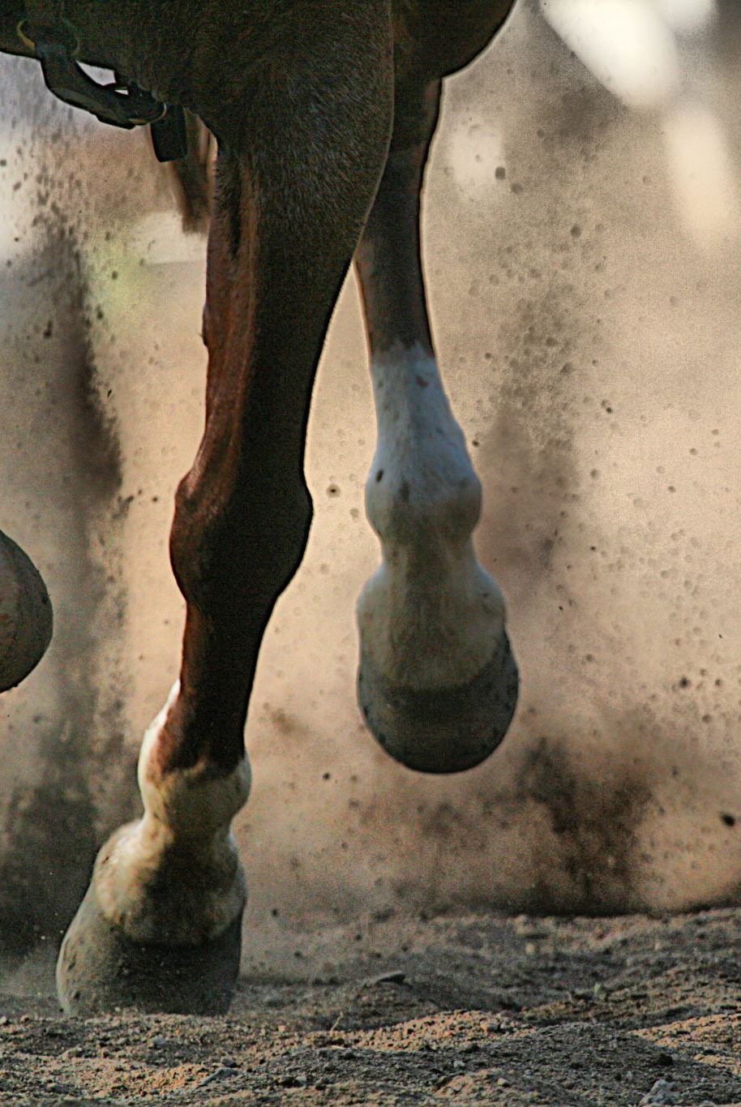
Quiz
How many muscles does an adult human have in their body?
How many muscles does a dog have?
How many muscles does a horse have?
Can you name any muscles that might be the same?

Slide 3
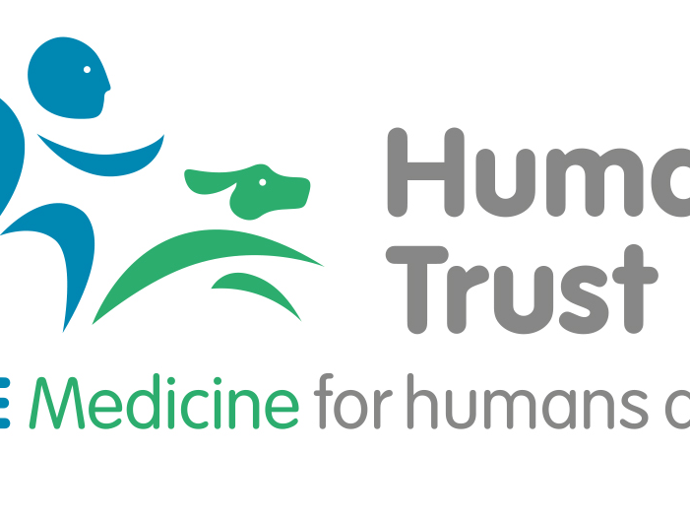
Muscles - in all mammals
Muscles attach to a bone by a tendon, the tendon is flexible to allow the movement required of them.
Muscles cross a joint and when they contract, they bend a joint. A muscle on the other side has to extend to allow the joint to bend and vice versa.
Muscle atrophy (muscle loss) is the wasting away of muscles. This can happen because of aging, illness, injury, reduced activity or lack of use of those muscles.

Slide 4

How similar are we?
Did you know?
Dogs and people share over 17,000 special genes called orthologs. Each pair of orthologs is derived from the same common ancestor via vertical descent and they tend to have similar functions.
This is why they are used as a comparative model for studying human health.
A new brain imaging study of humanity's best friend has found a striking similarity in how humans and dogs — and perhaps many other mammals — process voice and emotion.
We experience the world, through our central nervous system – so we see, feel, hear, taste and smell what is in our environment, and so do animals.
Lack of sleep in humans and animals has a similar effect on each.
There are lots more examples than these. In pairs you have ten minutes to think of as many more as you can.

Slide 5
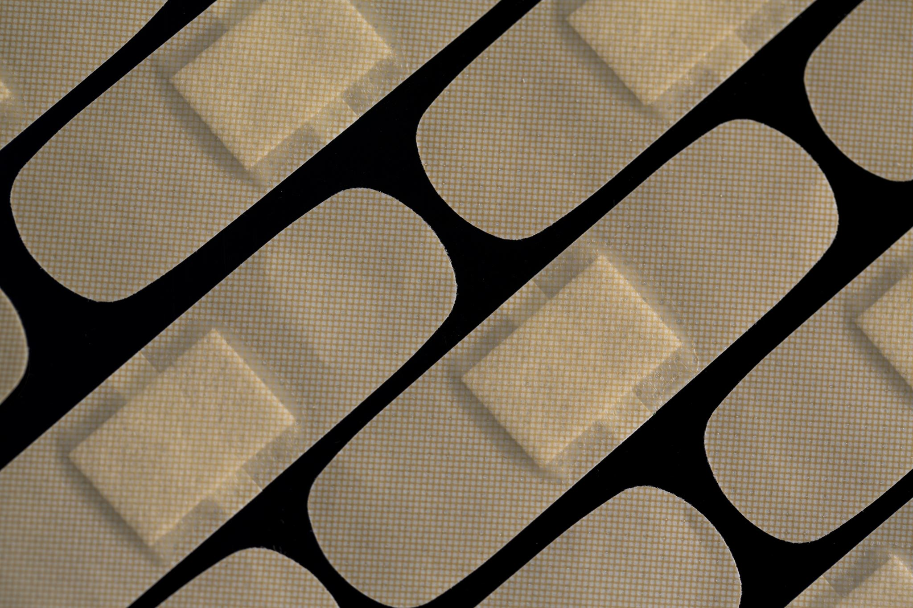
What do you do?
if you hurt yourself?
Parent/Teacher
Doctor
Hospital
How do you feel?
What happens next?

Slide 6
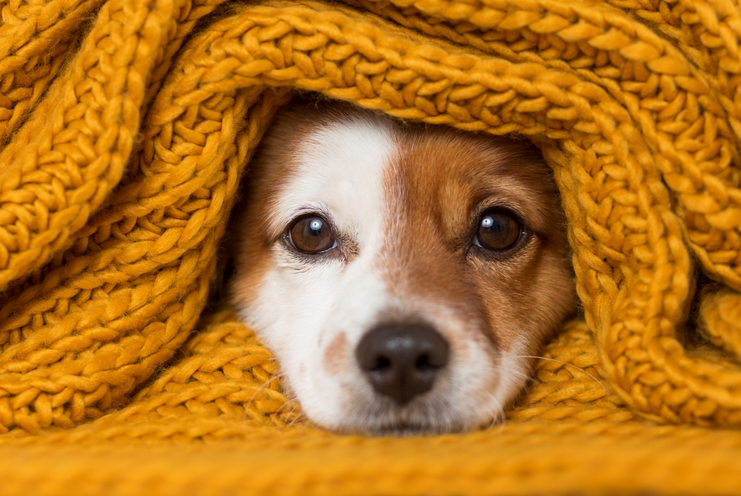
What do you do?
What do you do when your companion animal hurts themselves or is sick?
Parent
Vet
Referral vet surgery
How do you think they feel?
What happens next?

Slide 7

Healthcare
What happens if you have a large wound?
It is stitched.
What happens if you have a suspected broken bone?
X-rays (radiographs) are taken, if broken a plaster cast may be used, or surgery may be required.
If there is a bump and swelling?
A cold compress is applied initially
If you have an infection?
Antibiotics are prescribed
Blood tests may be taken and analysed to look for imbalances in the blood or organ efficiency.
  Guess what?

Slide 8

Healthcare
It is the same for our animals!
There are so many similarities between humans and animals, which is why the concept of One Medicine makes so much sense, for humans and animals.
All species benefit, as well as being more respectful to ALL beings, until animal testing is ended.

Slide 9
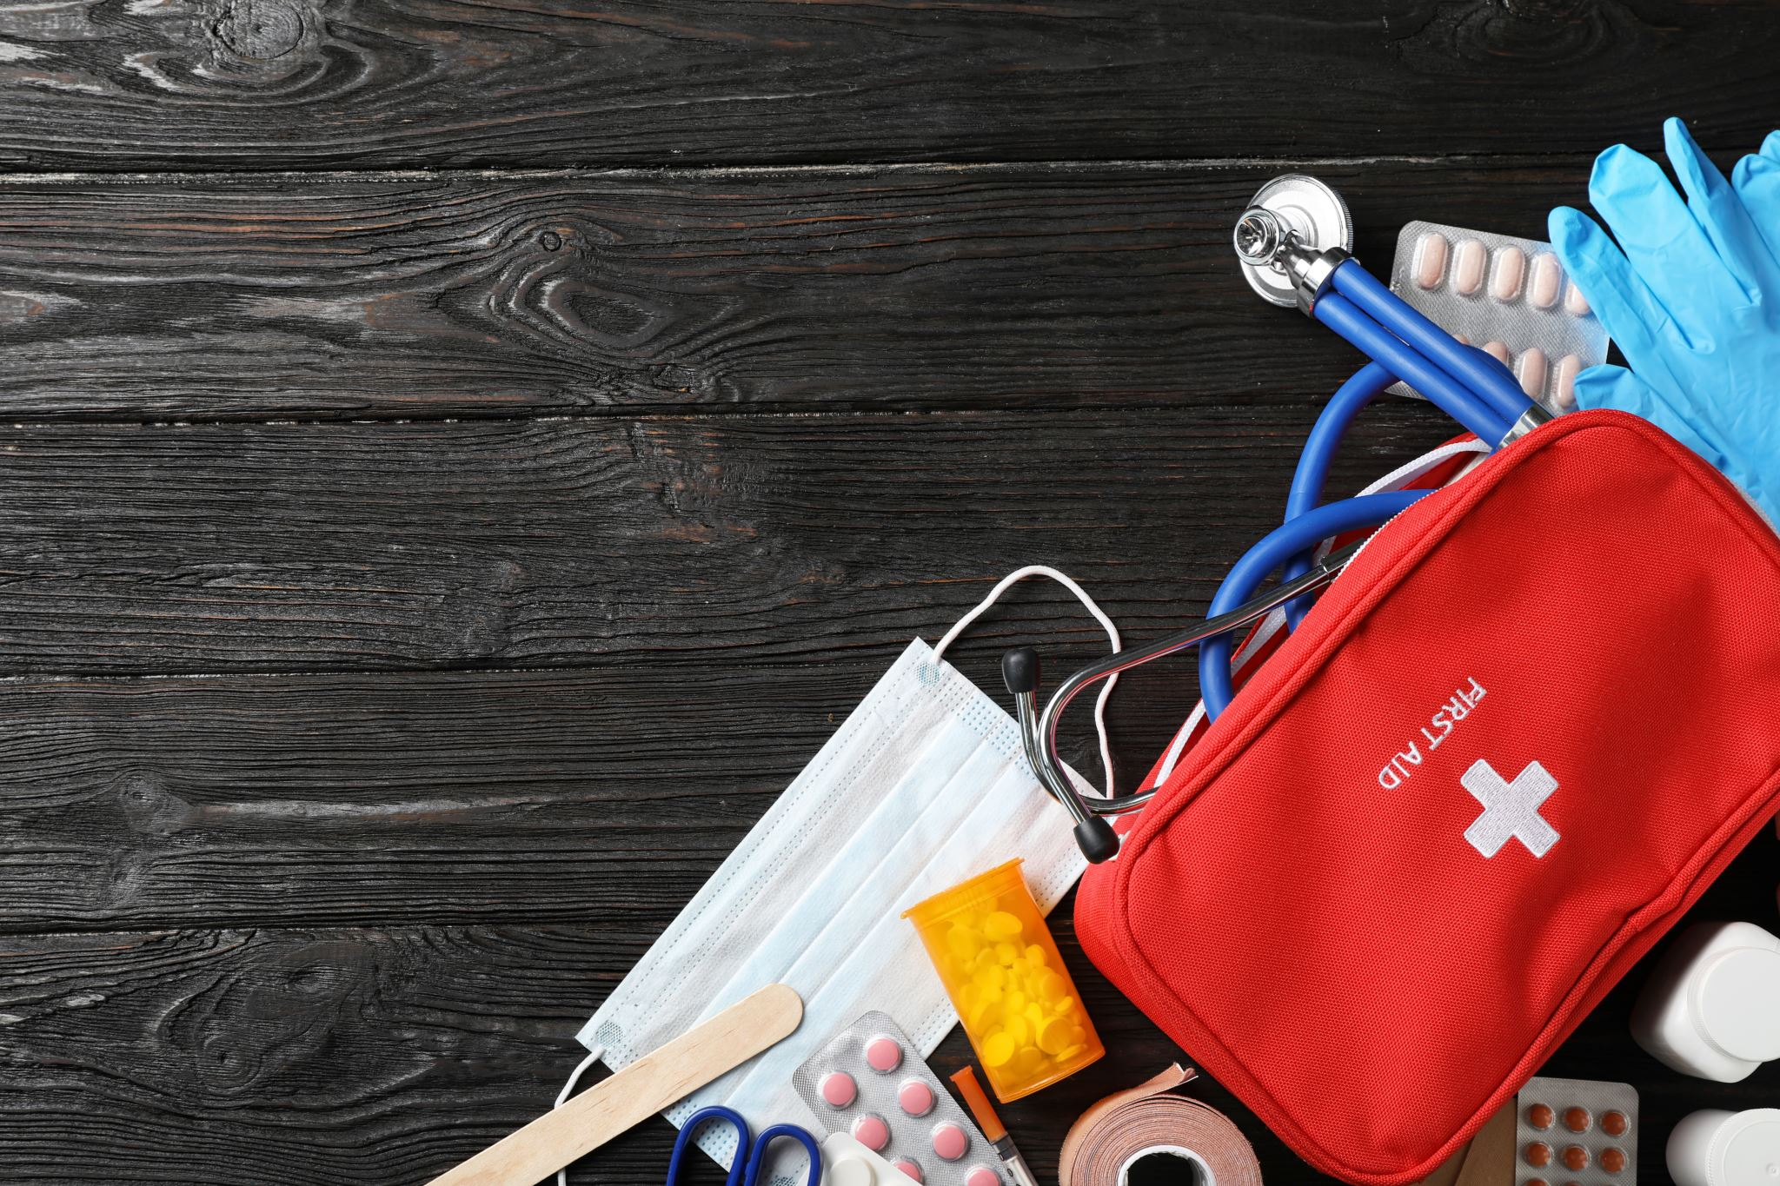
First Aid Kits
Human or animal?

Slide 10
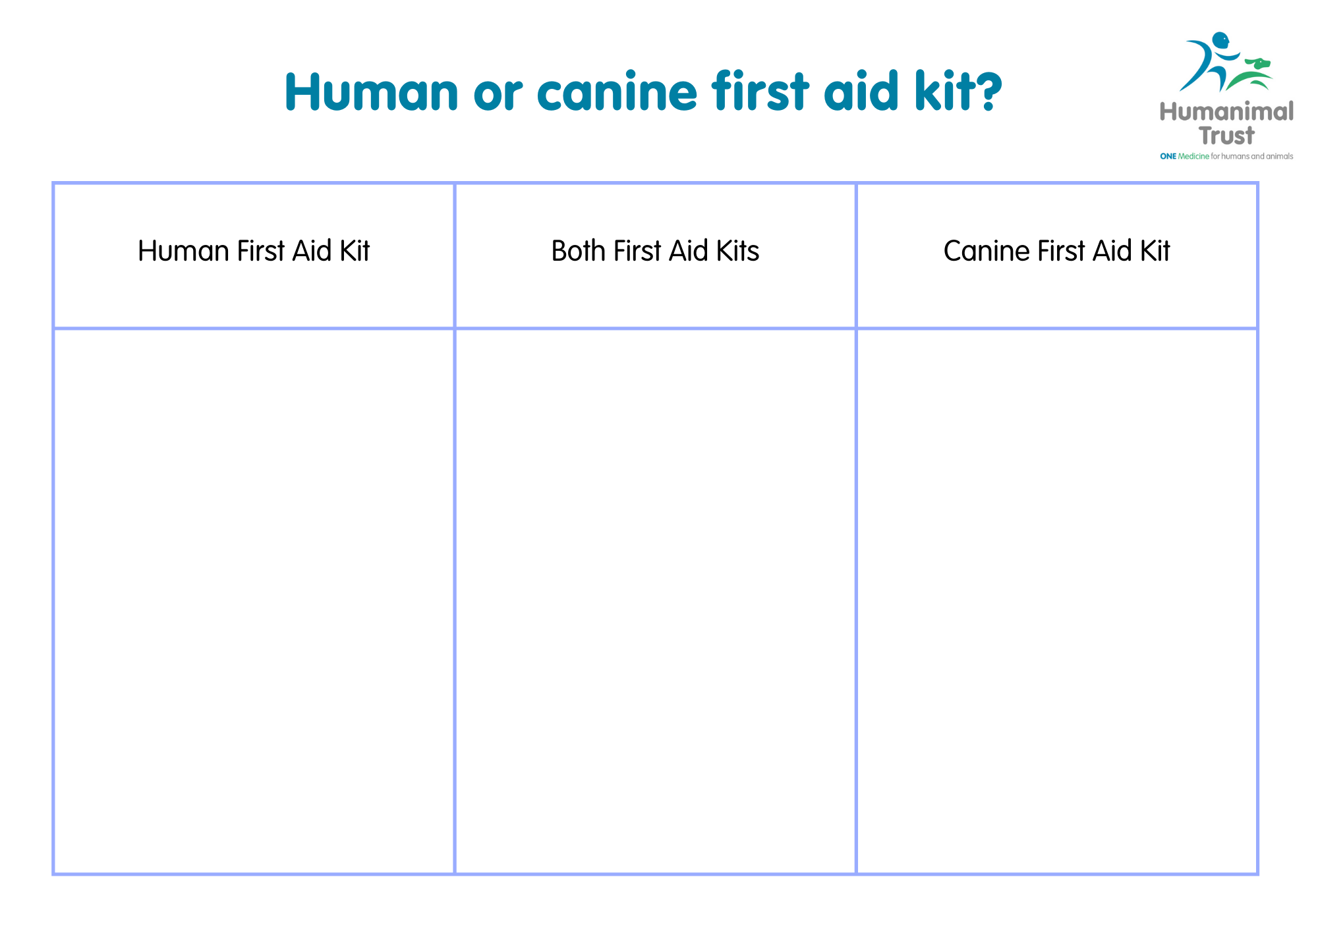

Slide 11
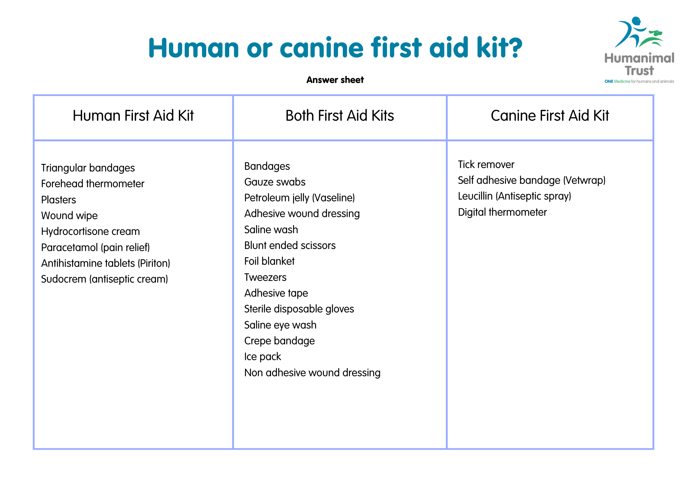
Answer slide

Slide 12
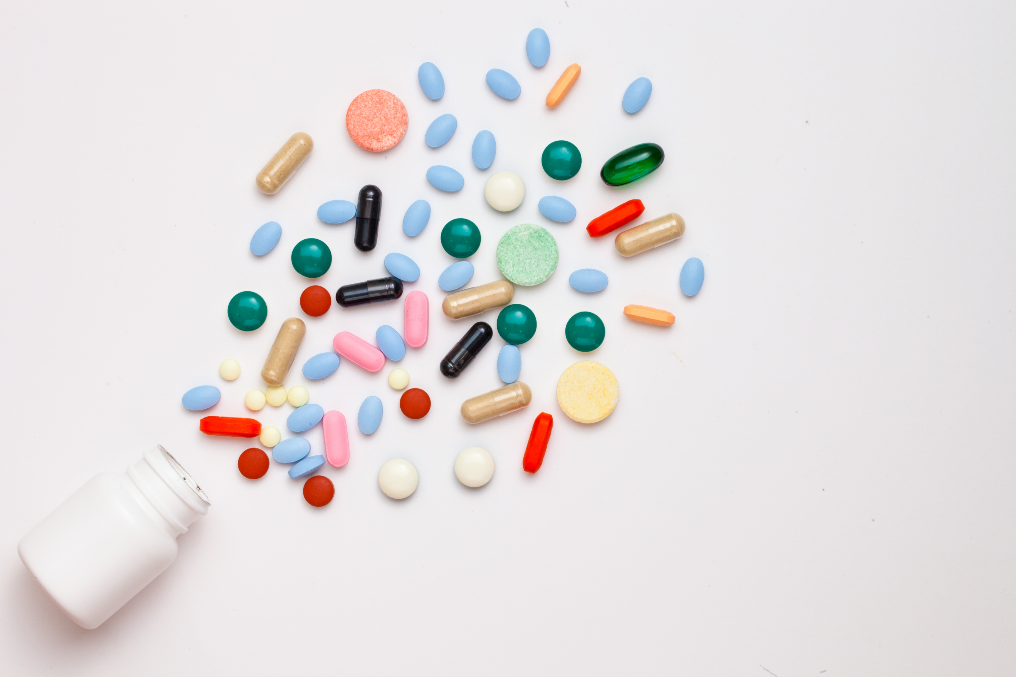
As an animal guardian
We should NOT give human medicines to our animals UNLESS a vet has prescribed it.
Your vet knows which medications are safe for our animals. The vet will assess the health of our animals and calculate the correct dose of the drug. Only a vet can do this
WARNING: Some human medicines are toxic to animals – do not give them anything your vet hasn’t prescribed.

Slide 13
First Aid Kits
Were there any surprises?

