Slide 1
Osteosarcoma in humans and dogs
Registered Charity No.s 1156927 & SC048960

Slide 2



What is Osteosarcoma?
Osteosarcoma is a type of bone cancer which occurs in both humans and dogs but the incident rate in dogs is approximately 10 times higher than in humans.
In dogs, it is most commonly found in longer legged dog breeds such as greyhounds and boxers, whilst in humans it most commonly occurs in children and teenagers.

Slide 3
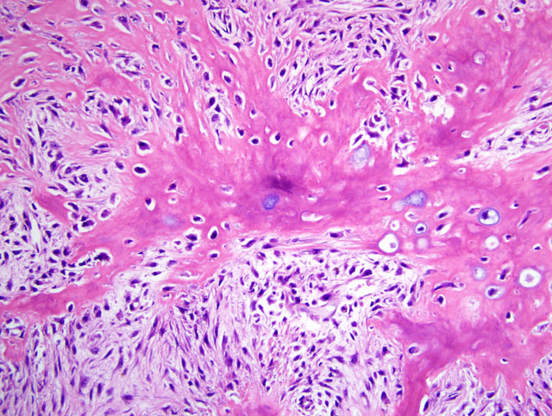
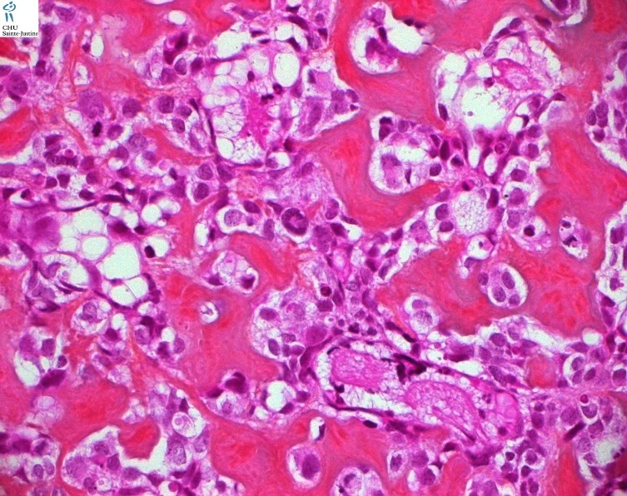
Osteosarcoma - the case for case studies and One Medicine
The two micrographs below are both of an osteosarcoma (a type of bone cancer) cell (but at different magnifications). One is from a human, the other is from a dog – but which is which?
Photo courtesy of OSA WSA
Photo courtesy of Humpath.com
Notes:
The answer is that the image on the left is of canine osteosarcoma, and the one on the right is of human osteosarcoma
Osteosarcoma is a type of bone cancer which occurs in both humans and dogs but the incident rate in dogs is approximately 10 times higher than in humans. In dogs, it is most commonly found in longer legged dog breeds such as greyhounds and boxers, whilst in humans it most commonly occurs in children and teenagers.
- Owing to the genetic make up or genome of an osteosarcoma cell, they are so similar in humans and dogs that it would be very difficult to tell them apart. Despite these genetic and physiological similarities, not just osteosarcoma but for many other diseases such as cancer, diabetes, arthritis etc, human and veterinary medicine do not routinely share their knowledge or work together. Humanimal Trust has helped to fund an ongoing research project at the University of Cambridge, in which researchers are looking for markers that may be able to predict the risk of a patient’s (human or animal) osteosarcoma spreading to other parts and organs of the body.

Slide 4
One Medicine – Medical and Surgical Oncology
Medical and Surgical Oncology

Slide 5
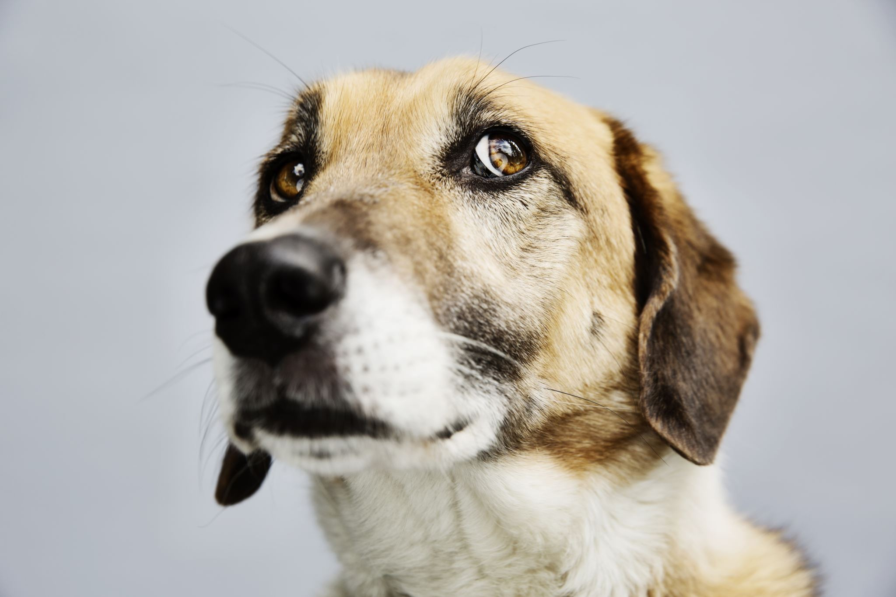
One Medicine – Medical and Surgical Oncology
Write a list, using bullet points, stating the similarities in how humans and dogs with osteosarcoma are treated.
Did anything surprise you?
Include this in your bullet points

