Slide 1
Understanding Pain
Registered Charity No.s 1156927 & SC048960

Slide 2
Pain
What do you know about pain?
Have you ever been in pain?
How did it make you feel physically?
How did it make you feel in yourself? Did it affect your behaviour?
Pain does affect our behaviour as well as the pain itself being uncomfortable
Did you know that?
Notes:
Did you know? Many animals hide their pain and as such the way to recognise pain in an animal, before they limp or you see other injuries/damage is through their behaviour.
With humans we KNOW they are in pain, because they tell us, sometimes repeatedly that they are. They can describe the pain and tell the doctor where it is. A vet has to use their eyes, palpation and the information for the guardian to work out what may be wrong with the animal.

Slide 3
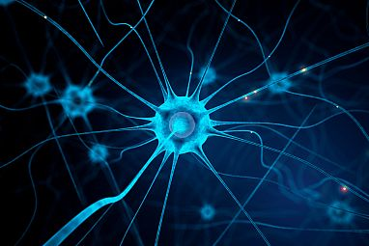
Pain is pain, right?
We often think pain is a simple cause and effect process. We touch something hot, that the nerves in the skin feel the heat and signals are sent to the brain to trigger a feeling of pain.
It is more complex than that though.
Neural circuits in pain and itch

Slide 4
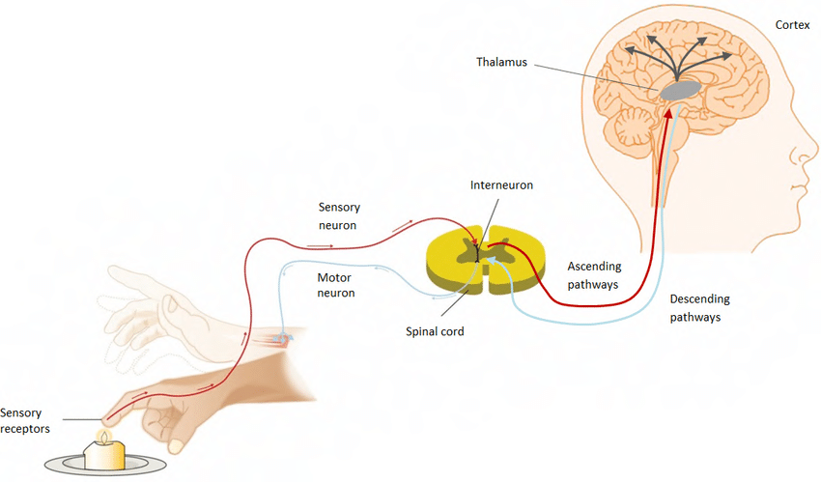
Human reflex arc
Notes:
Human reflex arc. Pain is generated in the skin surface and detected by nociceptors that warn the nervous system, this pain information is received in the spinal cord, and then sent to the brain through ascending pathways where the pain information is received and processed in the somatosensory cortex. The somatosensory cortex communicates this information to the motor cortex, which sends electrical pulses through descending pathways to react to the noxious stimulation by contracting the muscles and move from the source of pain. This is acute pain which is different to chronic pain.

Slide 5
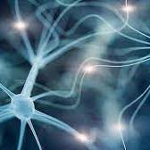
Pain
Research shows, that pain signalling, as well as the sensations the body perceives as pain, can be more complex than this simple example.

Slide 6
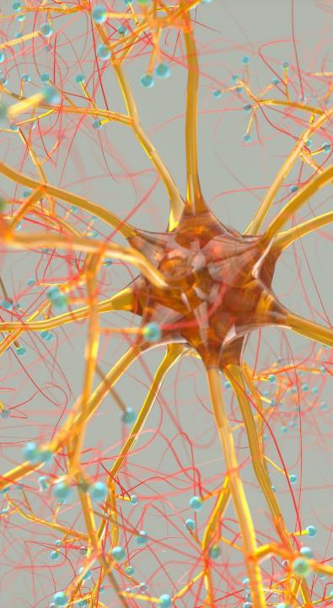
Pain Gate Theory
There is a gating process that determines which pain signals get through, and that’s the basis of the gate control theory, which was initially developed by Melzack and Wall in 1965. They wanted to propose that spinal nerves act as gates to let pain travel through to reach the brain — or close these gates and prevent pain messages from getting through at all.
Open gates. When the gates are open, you feel too much pain for too long. People with chronic pain conditions have gates that stay open even when they should be shut.
Closed gates. If you’ve ever injured two parts of your body at the same time, you understand that pain signals “compete” for our brain’s attention. It’s difficult for your brain to process pain from both areas at the same time. Other methods of closing certain gates include self-relaxation exercises and medication.

Slide 7

Pain
When you are doctors or vets, you will have to find out about your patients’ pain.
How will you be able to do this?
Ask questions
Palpate (feel) the area
Observations

Slide 8

What can a doctor ask their patients?
What type of pain is it?
How long has it been painful?
Where is the pain?
Describe the pain?

Slide 9
What questions can you ask your patients as a doctor?
Sharp and dull describe how pain feels, while short term or chronic describe how long pain lasts.
In pairs or groups up to fours, add more examples to the table on your sheet.
Feeling | strength | effect
shooting | mild | annoying

Slide 10
What questions can you ask your patients - answers
Feeling | Strength | Effect
Stabbing Shooting Burning Throbbing Itching Radiating Cramping | Mild Severe Minor Manageable Moderate Intense excruciating | Annoying Nagging Sickening Exhausting Distracting Blinding incapacitating

Slide 11
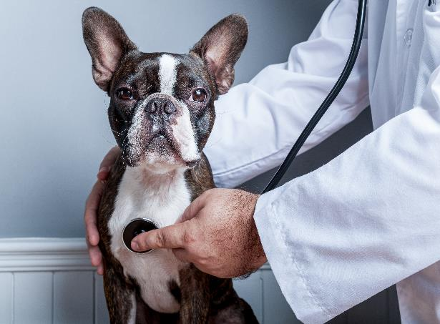
What can a vet do?
As a vet you can’t ask the animal where the pain is, or how they feel, so how can you find out if they are in pain?
Observations
Behaviour changes
Ask the guardian
Palpate the animal (if possible)

Slide 12
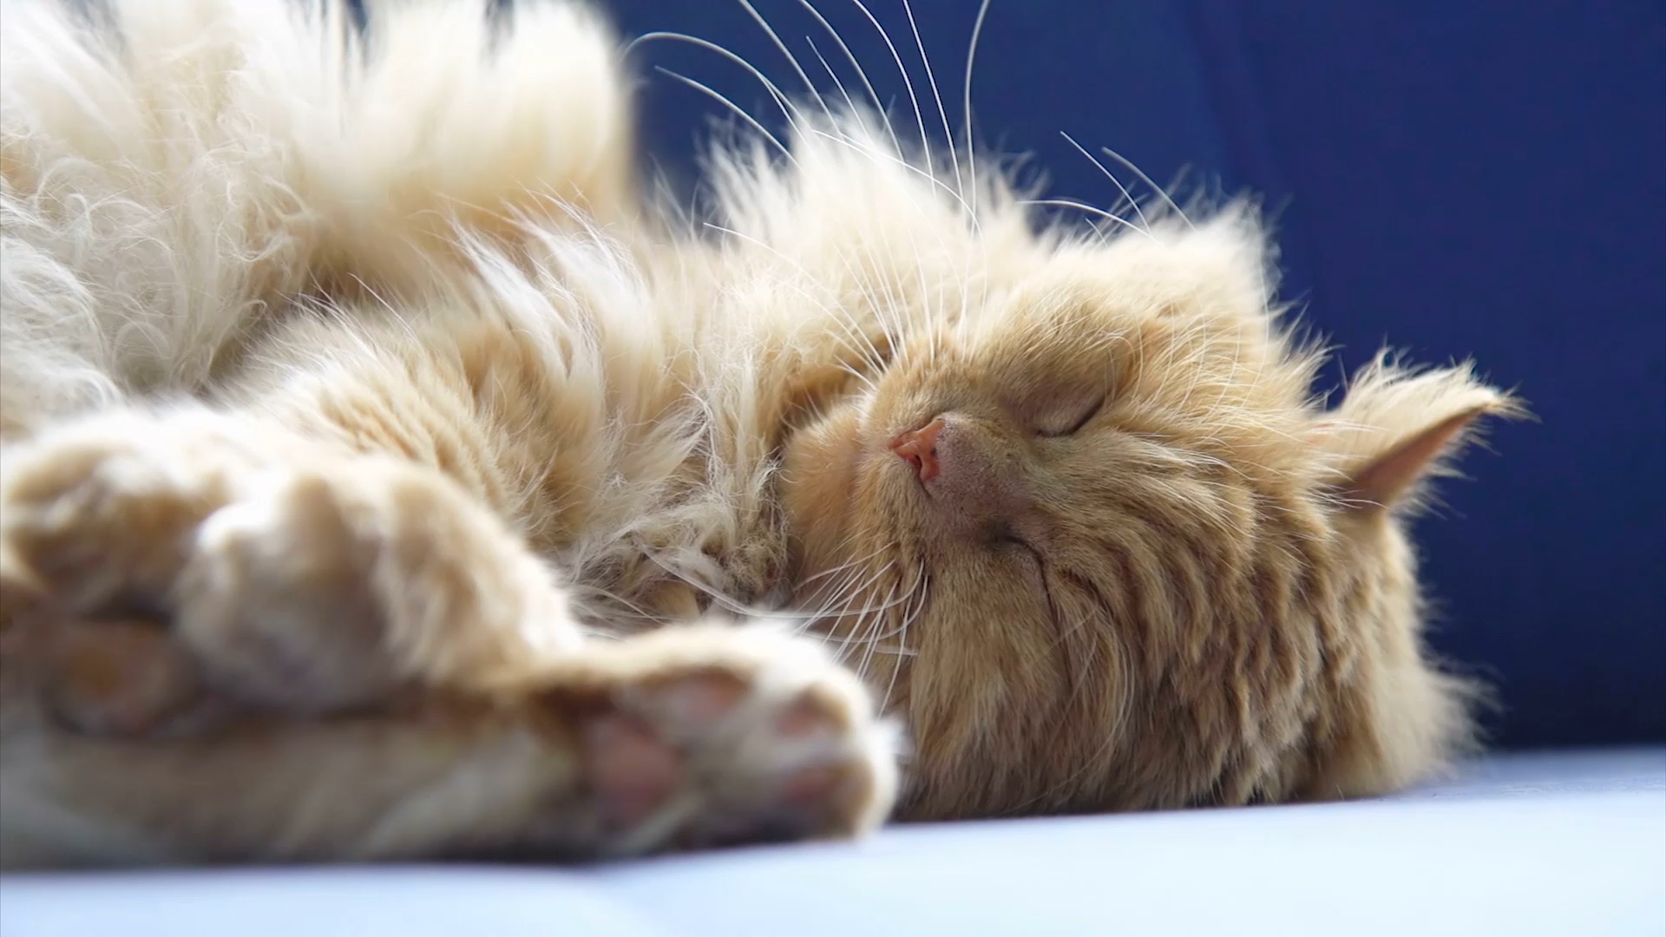
How might an animal exhibit pain?
In pairs or small groups, discuss what you may observe an animal doing that shows they are in pain.

Slide 13
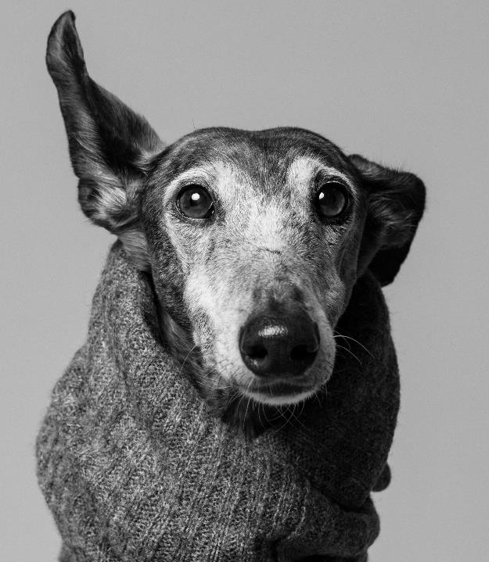
How might an animal exhibit pain?
We may see a change in:
Daily habits
Self mutilation
Change in activity level
Facial expressions
Posture and movement
Coat changes
Reactivity
Some of these changes are very subtle requiring us to be really observant of the animal’s behaviour.

Slide 14
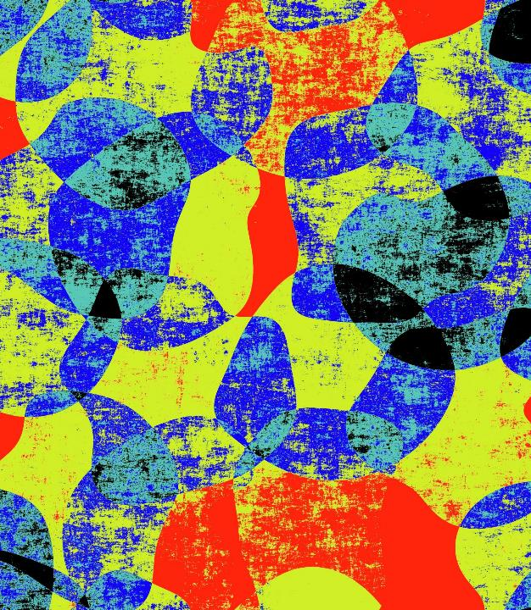
How will One Medicine help regarding pain?
What do you think based on what you have learnt?
Discuss in a small group
Notes:
If we know what is a painful condition in people, we will know that it will be painful in animals.
Assessing the types of pain could help with the correct medications being prescribed to people and animals, helping us find medical solutions for humans and animals.

