Slide 1
Understanding Viruses, Bacteria and Antibodies
Registered Charity No.s 1156927 & SC048960

Slide 2
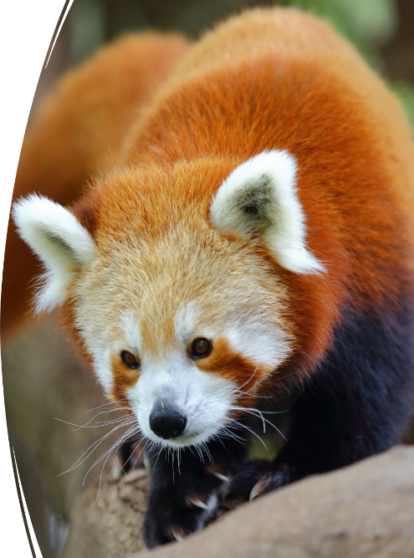
Zoonotic Diseases
Over 60% of all known infectious diseases are shared between humans and animals
World Health Organisation (WHO)

Slide 3
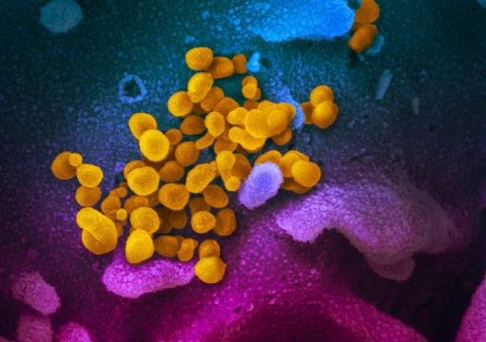
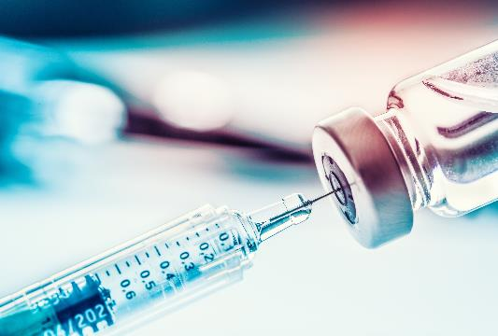
What is a virus?
Viruses are the smallest of all the microbes.
They are unique because they are only alive and able to multiply inside the cells of other living things, including bacteria, plants and animals.
Many viruses cause diseases in humans, such as:
influenza
Covid-19
Chicken pox
the common cold
and rabies
Image courtesy of NIAID-RML
Notes:
1. They are said to be so small that 500 million rhinoviruses (which cause the common cold) could fit on to the head of a pin. We need a microscope to be able to see them
2. The cell they multiply in is called the host cell. The viral replication process begins when a virus infects its host by attaching to the host cell and penetrating the cell wall or membrane.
3. The primary way to prevent viral infections is vaccination, in order to increase the individual's immunity to the disease.
This image is of COVID-19 coronavirus is seen in yellow, emerging from cells (in blue and pink) cultured in the lab. This image is from a scanning electron microscope.

Slide 4
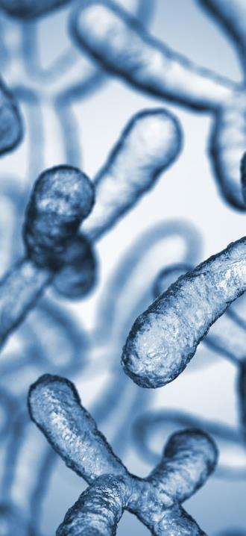
What are bacteria?
Bacteria are microscopic, often single-celled organisms that exist in their millions, in every environment, both inside and outside other organisms.
Bacteria were among the first life forms to appear on Earth and are present in most of its habitats.
Some cause infections and disease in animals and humans while other bacteria are good for us and animals and they are vital to the earth’s ecosystems.
Notes:
You also have good bacteria within and on your own body. Did you know that you have ten times more bacterial cells in your body than you have human cells? Most of these bacteria are in your digestive system.
Many of them are in our guts and help us digest our food. The two most common species of helpful bacteria found in our gut microbiome are Lactobacillus and Bifidobacteria.

Slide 5
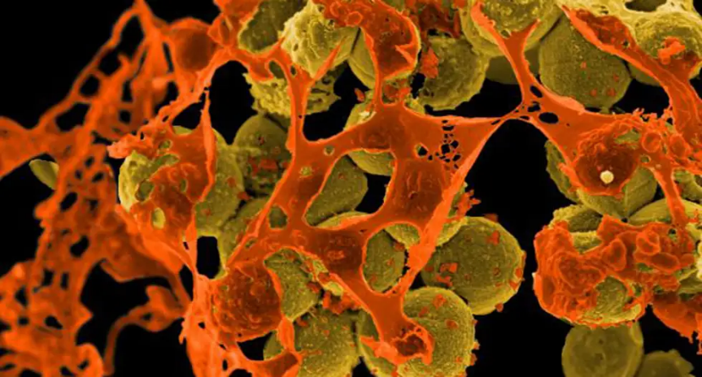
MRSA – a super bacteria
A micrograph of methicillin-resistant Staphylococcus aureus (MRSA, brown) surrounded by cellular debris. MRSA resists treatment with many antibiotics. (Credit: NIAID)
Notes:
Staphylococcus aureus is a very common bacteria often found growing harmlessly on the skin. Although originally responsive to penicillin, strains soon emerged that were resistant to the antibiotic. When a derivative of penicillin called methicillin was developed to combat these strains, Methicillin-resistant staphylococcus aureus (MRSA) materialised. The antibiotic resistance of MRSA strains continue to become stronger and some strains of this superbug are now resistant to virtually all know treatments.
The immune system of healthy individuals can usually ward off an MSA infection without hee need for antibiotics, but in the infirm it can be very serious. Thes best way to to prevent the spread of MRSA is simple attention to hygiene, particularly hand washing. Also fi someone is prescribed antibiotics by a doctore you must complete the dose, If you stop as soon as you feel a bit better, you may have only dispatched the weaher strains of the bacteria, allowing the deadlier ones to survive and flourish.
This is one of the diseases that has become antibiotic resistant and why we should be looking at this from a One Medicine approach, only using antibiotics when absolutely necessary and working together to find alternative solutions.

Slide 6
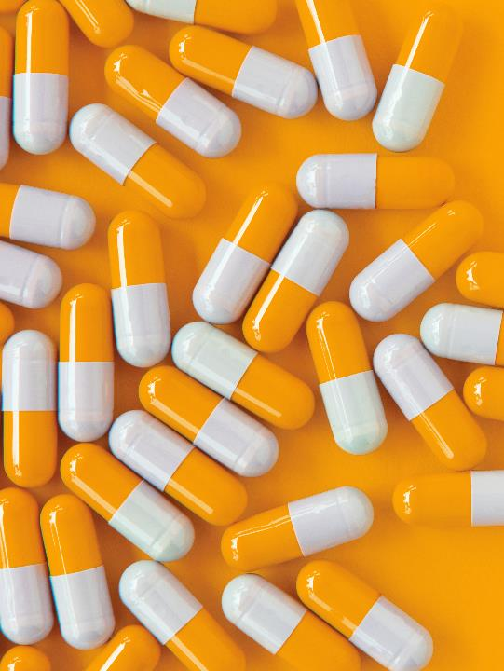
Antibiotics
Antibiotics are medications, some very strong, that are used to treat or prevent some types of bacterial infection.
Antibiotics aren't effective against viral infections. This includes the common cold, flu, most coughs and sore throats.
Notes:
Antibiotics work by killing or preventing bacteria from spreading.

Slide 7
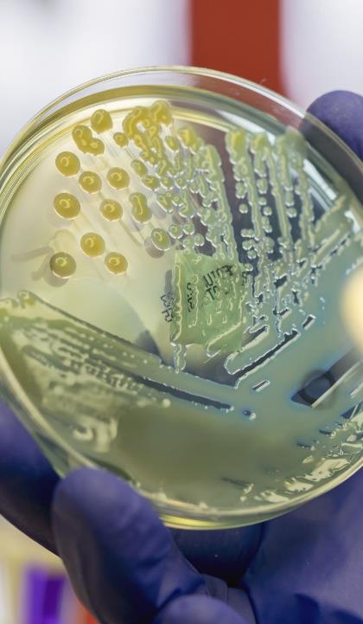
Facts about Antibiotics
Alexander Fleming discovered penicillin, the first natural antibiotic in 1928
Fleming predicted the rise of antibiotic resistance
Antibiotics either kill or slow down the growth of bacteria

Slide 8
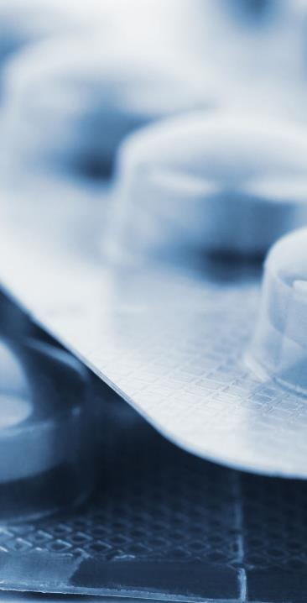
Anti-microbial resistance (AMR)
This is a global health issue.
Solutions to the problem requires a collaborative approach, due to the many ways antibiotics are used.
Veterinary use has been seen as part of the larger issue. They use around one third of all antibiotic ingredients in the UK.
https://www.frontiersin.org/articles/10.3389/fvets.2020.513770/full
We NEED a One Medicine approach
Notes:
1. Antibiotics underpin modern medicine and since the 1940s have also been used in animals, both therapeutically and non therapeutically.
The development of the antimicrobial resistance is a naturally occurring process for bacteria , the spread of multi resistant strains has been accelerated by the excessive and inappropriate use of antibiotics. Because of this, antibiotics use has been recognised for a long time as a significant contributor to the AMR crisis.
2.
3. Research on antibiotic use has focused on its use in the livestock industry, farming, where antibiotics have been used as growth promoting agents and prophylactics ( as a preventative). Concerns about AMR and the cross over into human medicine, the use of antibiotic growth promoters were banned int eh EU in 1997. However the complexities of managing health and disease in livestocj as well as ensuring food safety, means that the use of antibiotics in livestock is still very high.

Slide 9
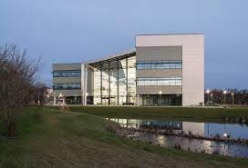
Research projects funded by Humanimal Trust
Bacteriophages as an alternative to antibiotics (PhD studentship)
Dr Lucy Grist – recipient of first Humanimal Trust PhD studentship
Investigated the ability of phages to target and kill strains of Escherichia coli which had caused infections in canine patients

Slide 10
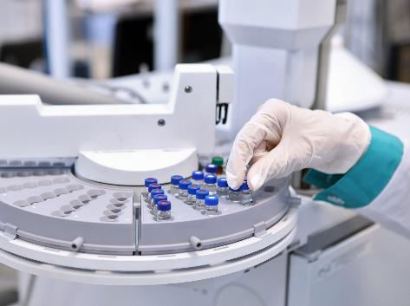
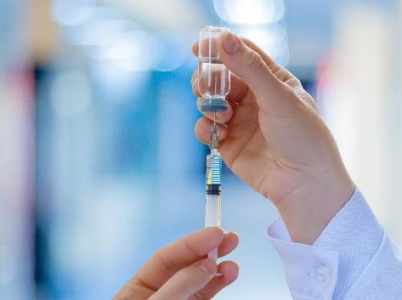
The Immune System
  If pathogens pass the first lines of defence, they will cause an infection..
  The body has a second line of defence to stop or minimise this infection, the immune system.
  The antibodies help identify foreign interlopers such as viruses, bacteria
  or toxic chemicals.
  Vaccines can help prepare the bodies for threats they have not encountered before.
Notes:
A non specific line of defence could be hand washing, using a tissue, coughing into the crook of your arm.
2. The immune system consists of white blood cells and Y shaped proteins called antibodies.
White blood cells attack harmful bacteria.
Even if there are symptoms, so someone has been infected , the immune system can usually cope and fend off the infection. However, sometimes the number of harmful bacteria are excessive and the immune system cannot get rid of them all , this is when antibiotics can be useful.
3. Antibodies work by grabbing onto suspicious antigens using the tips of their arms and holding fast until other immune system cells have a chance to neutralise the threat.
4. By giving a sneaky peek at epitopes found on genuine threats, the vaccines train antibodies to respond quickly if they encounter the same threat again, allowing the body to neutralize it before it has a chance to fully develop.

Slide 11
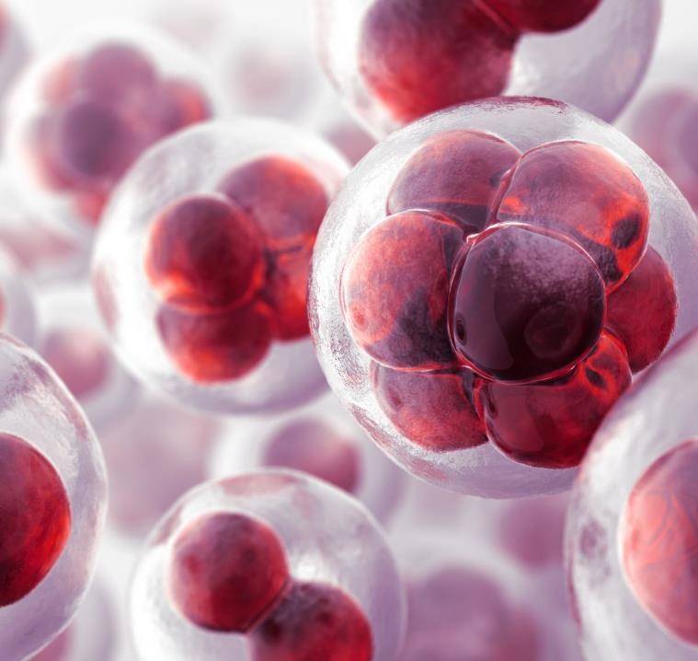
Antibodies
Our immune systems are really important to keep us healthy, we can do lots to keep it healthy, by looking after ourselves.
We are going to each make our own antibody with origami!
British Immunology website origami antibody

Slide 12
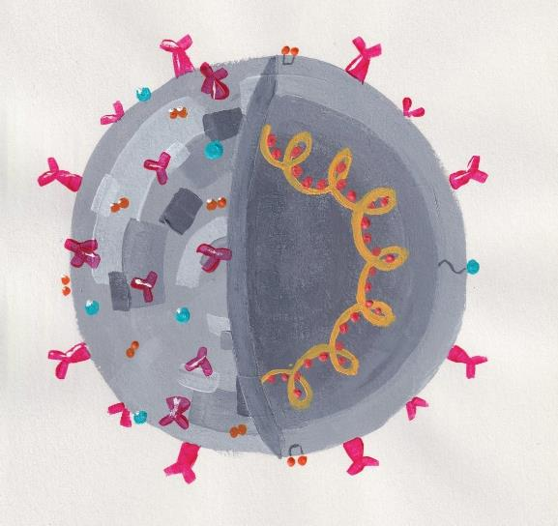
Plenary
Create a definition of a virus
Courtesy of Ash Uruchurtu, from the book Infections: Pathogens and How We Fight Them

Slide 13
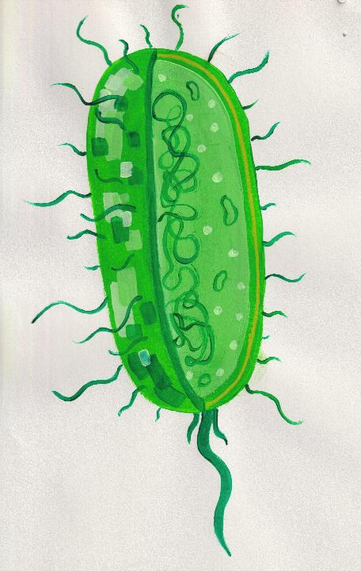
Plenary
Create a definition of a bacteria
Now compare the difference between a virus and bacteria
Illustration courtesy of Ash Uruchurtu, from the book
Infections: Pathogens and How We Fight Them

Slide 14
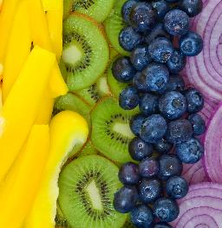
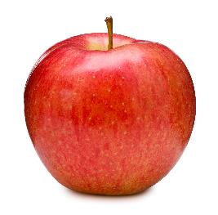
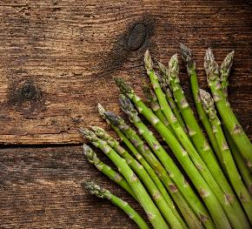
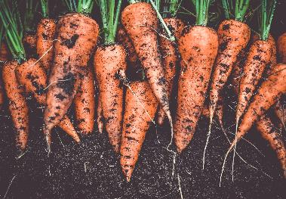
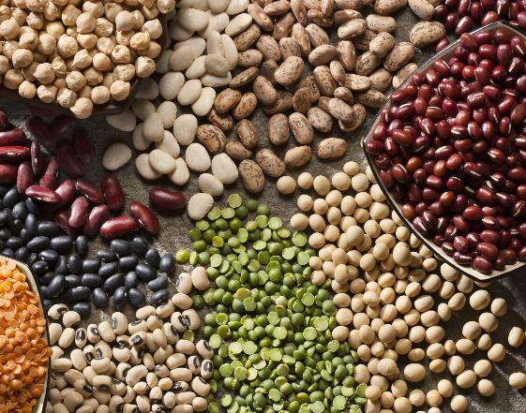
Stay healthy!

