Slide 1
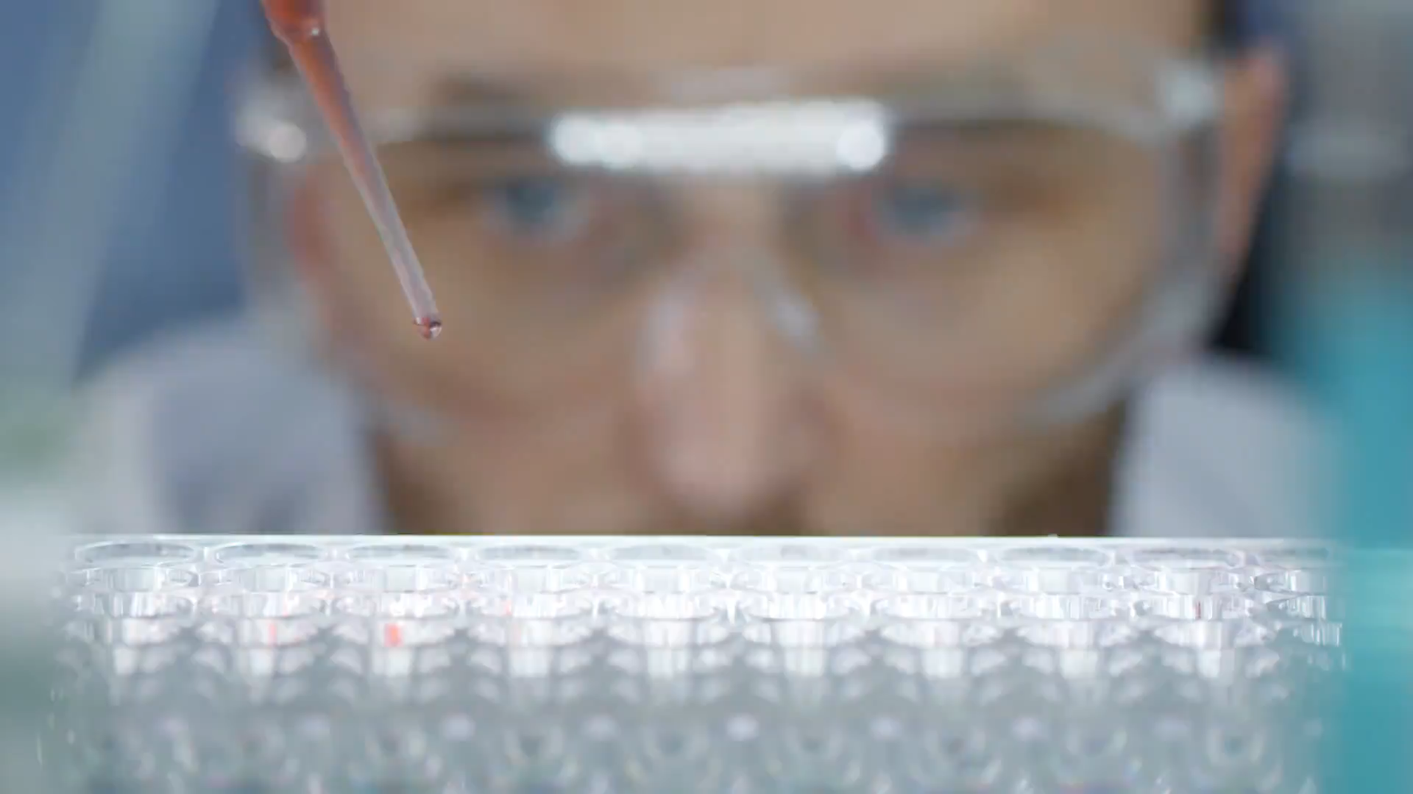
So, you want to be a doctor, vet, dentist, researcher?
You have to get into a university first

Slide 2

University choices
Have you decided on which universities you wish to apply to?
Typically in May each year, the courses for the following year will be shown on UCAS
You can start your undergraduate application in May, but can’t submit it to UCAS until September.
Applications close, usually, in October for courses at Oxford or Cambridge Universities and for most medicine, veterinary medicine/science and dentistry.
Applications close typically at the end of January for the majority of courses
https://www.ucas.com/undergraduate/applying-university/ucas-undergraduate-when-apply

Slide 3

What can you do to prepare for your application?

Slide 4

The interview
How can you prepare for your interview?
Today we are going to practice the interview
scenario
Imagine you have arrived (early) at your university of choice for your interview.
Take in the surroundings. What can you see? What is the department like? Do you really want to be here?

Slide 5

The interview questions
Spend 5 minutes with your neighbour thinking about the types of questions you may be asked at your interview.
Include at least one from each of these categories:-
~Background, motivation and personal insight
~Interest in medicine/veterinary/dentistry
~Teamwork
~Work experience
~Medicine and society
I asked some university tutors who are involved in university interviews what kind of questions you will be asked; I want you to read through these and prepare the answers you would like to give.

Slide 6
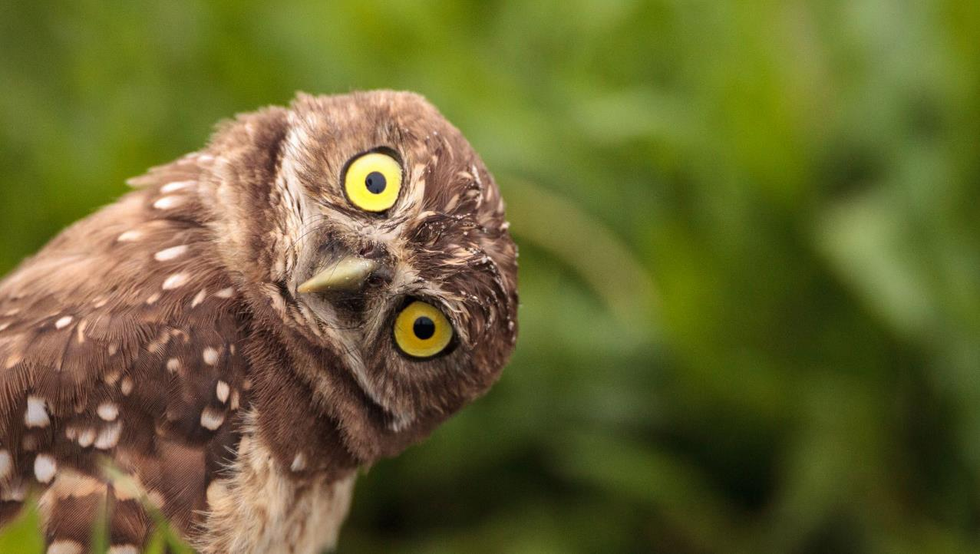
Be a wise owl….
Be prepared!
Why do you want a career in….?
What have you done to explore the…. (health service, veterinary medicine or dentistry) have you undertaken any work experience?
What do you think of….. (read up on the latest information in your field an awareness of the current thinking)
What qualities do you think might be expected from a doctor/vet – student?
How would you balance your outside interests with studying for your degree?
What responsibilities do you have?
Have you heard of One Medicine? How would this improve healthcare?
Can you name any of the biggest challenges facing medicine?
What can we do about these challenges? (Antimicrobial resistance or zoonotic diseases would fit well as subjects within these last questions)

Slide 7

Body Language
It isn’t just what you say, it is so much more!
Presenting a good picture of yourself through your body language requires preparation and practice. Here are a few tips that can make the process easier:
Handshake
Posture
Legs
Hands
Eye contact
Mirroring
Entering and exiting the room
Responsiveness

Slide 8

Pause here for students to practice their interview techniques with each other

Slide 9
How did you feel in the “interview?”
Did you find this exercise beneficial?
Did you find an area you need to work on prior to your interviews?
https://www.rcseng.ac.uk/careers-in-surgery/careers-support/applying-to-medical-school/interview-questions/
You have got this!

Slide 10

Part 2
Group Activity

Slide 11

How to act in the group interview
Your goal in the group interview is to stand out (in a good way) so remember your body language from the previous lesson as well.
Make friends with the rest of the group. Not only is this a good opportunity to meet new people, you will come across as confident and relaxed.
Involve everyone in the group. If you can address them by name and reference an earlier discussion that helps you stand out as a leader.
Build on previous answers given by other members of the group. This avoids repetition of someone else's answers.
Be yourself, be willing to speak up within the group but not take over Speak with purpose, you don't have to be speaking all the time, but when you do make sure it is with purpose. Make sure what you are saying is unique.
Don't forget to listen! To speak purposefully you have to be able to follow the flow of the conversation and make your point at the correct point in the discussion.

Slide 12

Group activity
Some universities use an observed group task as part of the interview process.
I would like you, in small groups, to explore and discuss the concept of the 3Rs –
and come up with a 4th R as a group, that would be a One Medicine
Notes:
The RAF use this activity as well.
The next slide shows what the 3Rs are – The principles of the 3 Rs were developed over 50 years ago by William Russell and Rex Burch in 1959. They were to provide a framework for performing more humane animal research.

Slide 13
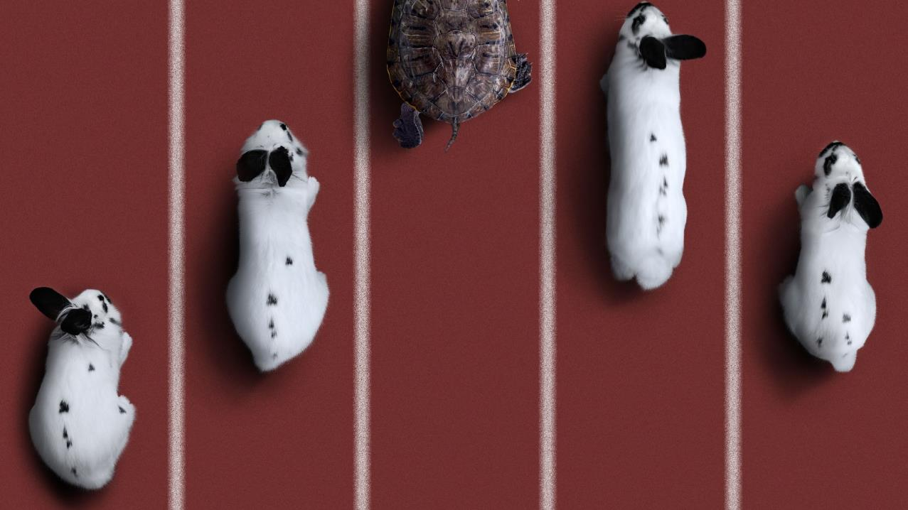
The 3 Rs
The principles of the 3 Rs were developed over 60 years ago by William Russell and Rex Burch in 1959. They were to provide a framework for performing more humane animal research.
Replacement
Reduction
Refinement
Humanimal Trust does NOT fund any research which involves the use of experimental animal models

Slide 14

The 3Rs
Replacement – Avoiding or replacing animal use e.g. using cell cultures, computer modelling, or human tissue or volunteers.
Reduction - Where animal use is necessary, keeping numbers to the minimum e.g. using statistical methods to determine the smallest number of animals that can be used in an experiment.
Refinement - Where animal use is necessary, minimising pain and suffering and improving welfare e.g. using pain relief, provide housing that allows animals to perform their natural behaviours and handle them more sympathetically and appropriately.

Slide 15
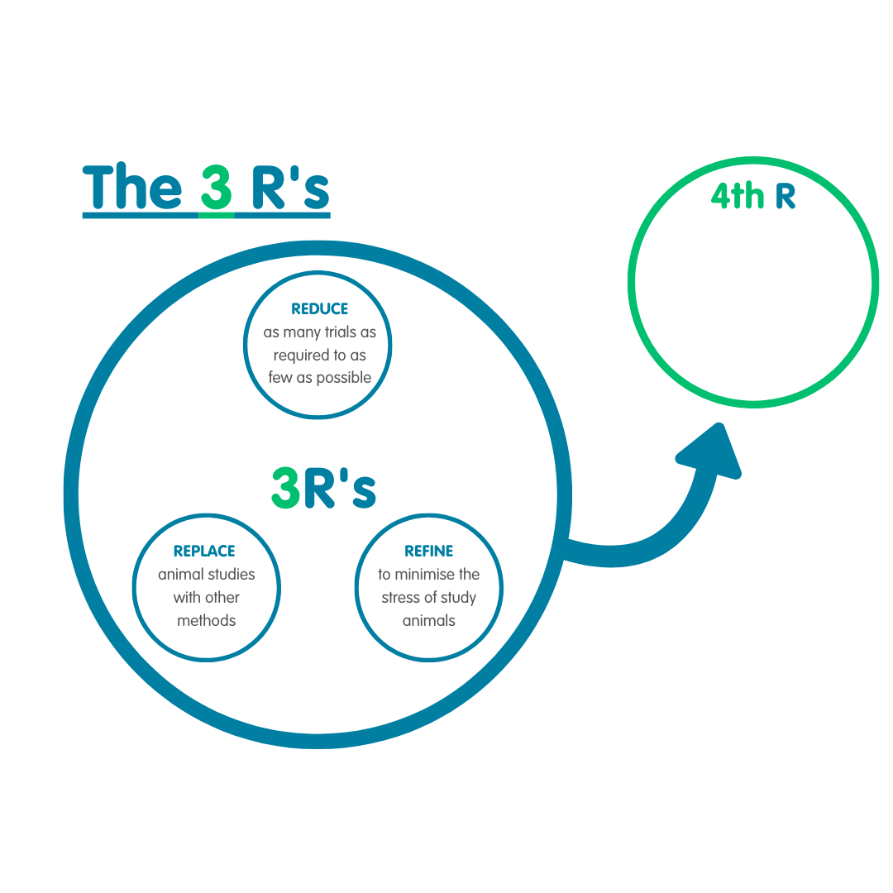
The 4th R

Slide 16
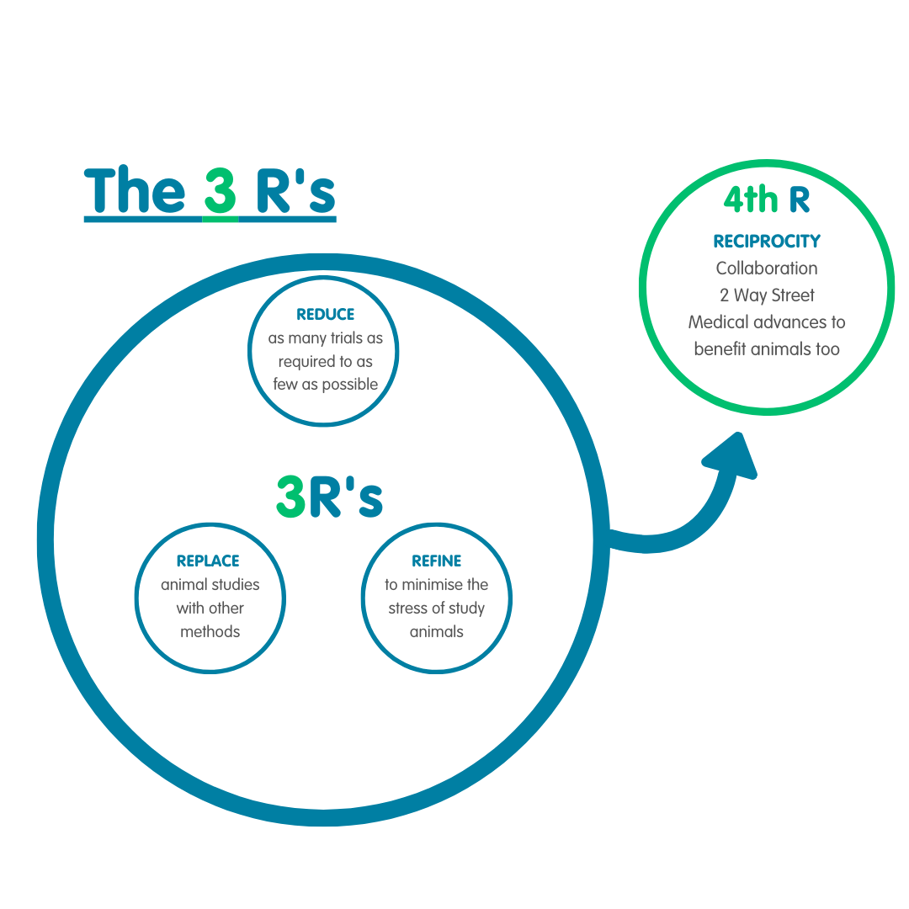
The 4 Rs

Slide 17
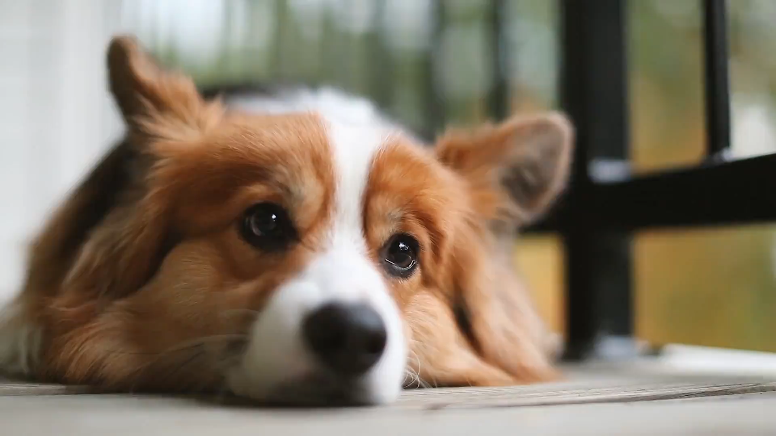
Our aim is a world, where animal experiments are no longer carried out.
Where animals, via a strict ethical framework that ensures their best interest, can take part in clinical research, (the study of health and illness that is naturally occuring) in the same way humans do.
Ensure health treatment is equally available for both humans and animals.

Slide 18
How did you feel in the “Group interview?”
Did you find this exercise beneficial?
Did you find an area you need to work on prior to your interviews?
https://www.rcseng.ac.uk/careers-in-surgery/careers-support/applying-to-medical-school/interview-questions/
You have got this!

