Slide 1
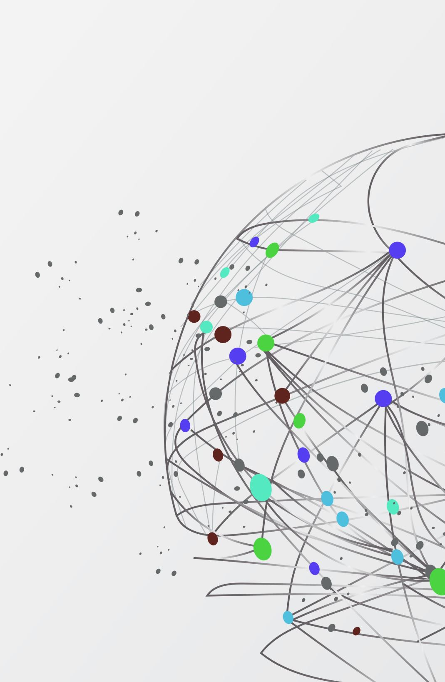

Debating One Medicine

Slide 2
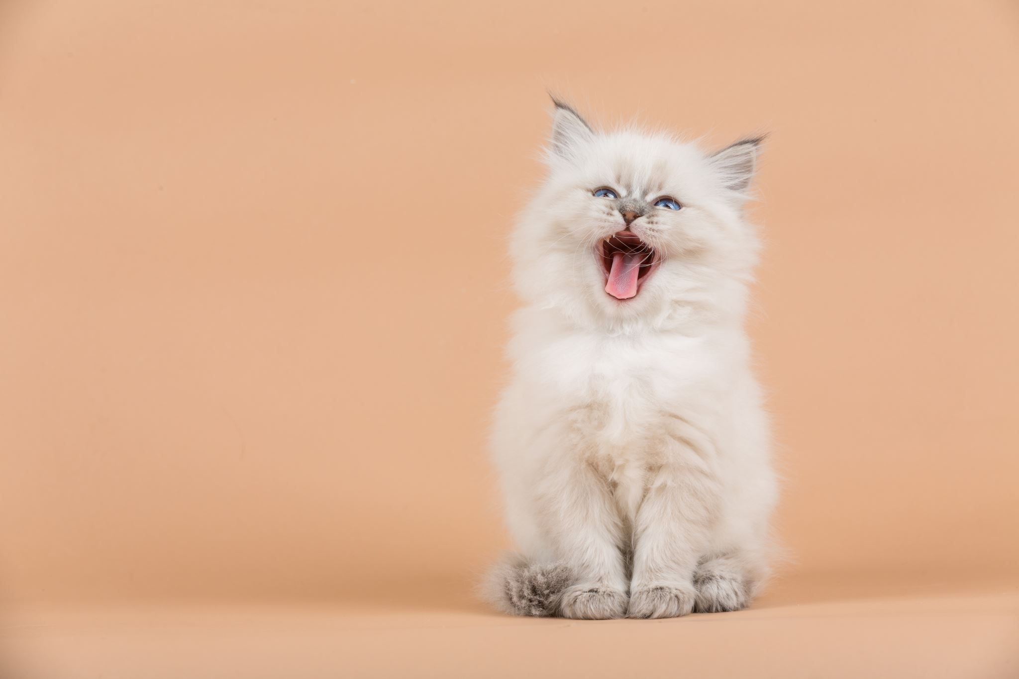
I Disagree!
Student 1 says “Every family should have a cat”
Sit in a circle and each of you will take it in turns to make a statement, you can either make one up yourself or pick a card.
You are going to say this out loud. Once this has been shared, the person next to them will say “I disagree…..”and needs to give one reason why they disagree with the statement.
Student 2 replies “ I disagree. Every family shouldn’t have a cat because some people are allergic to cats”
Student 2 says, “Schools shouldn’t have long summer holidays

Slide 3
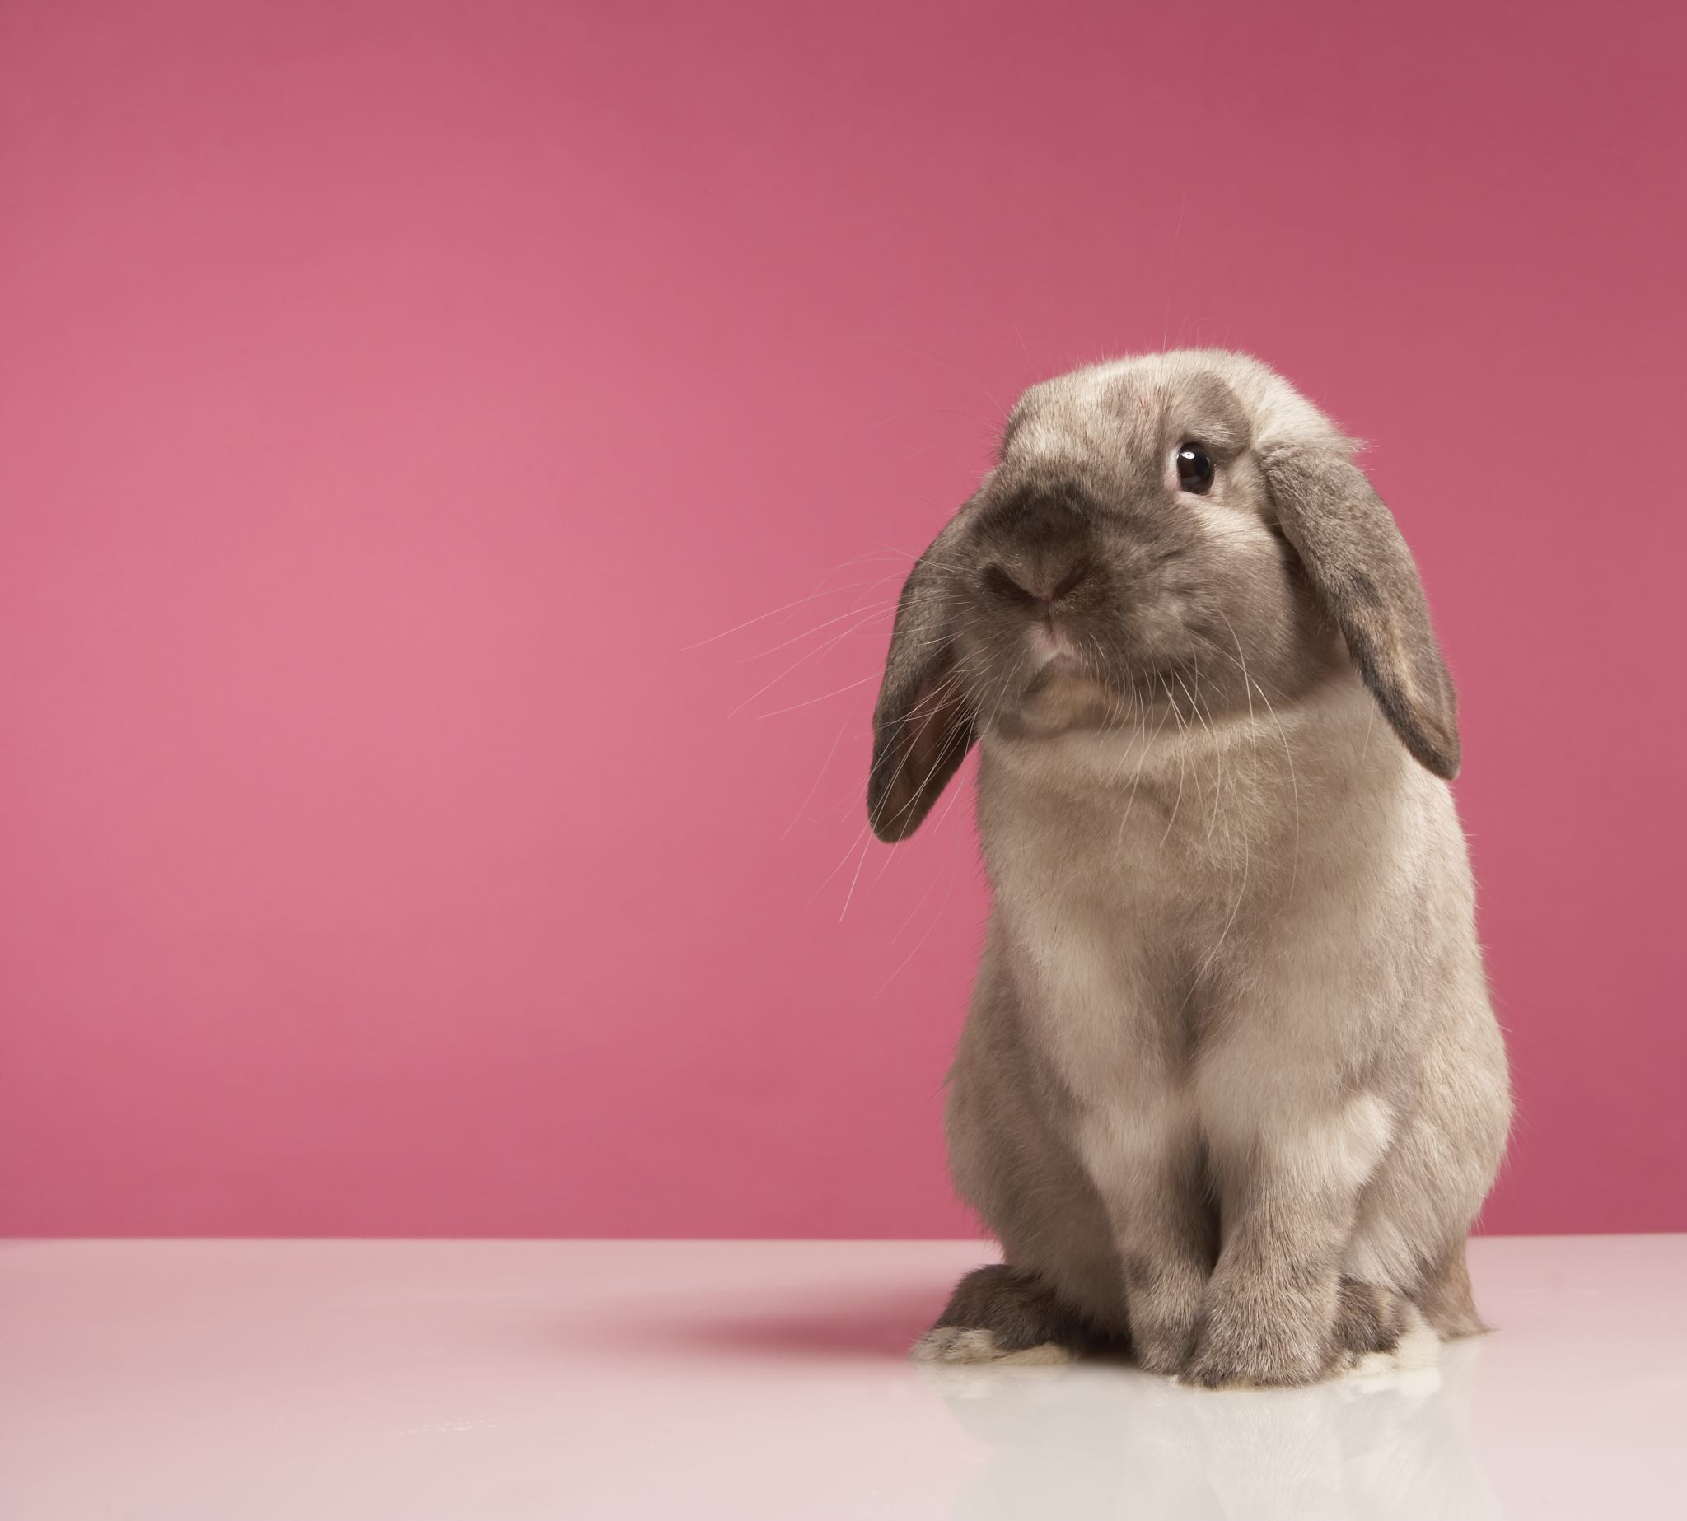
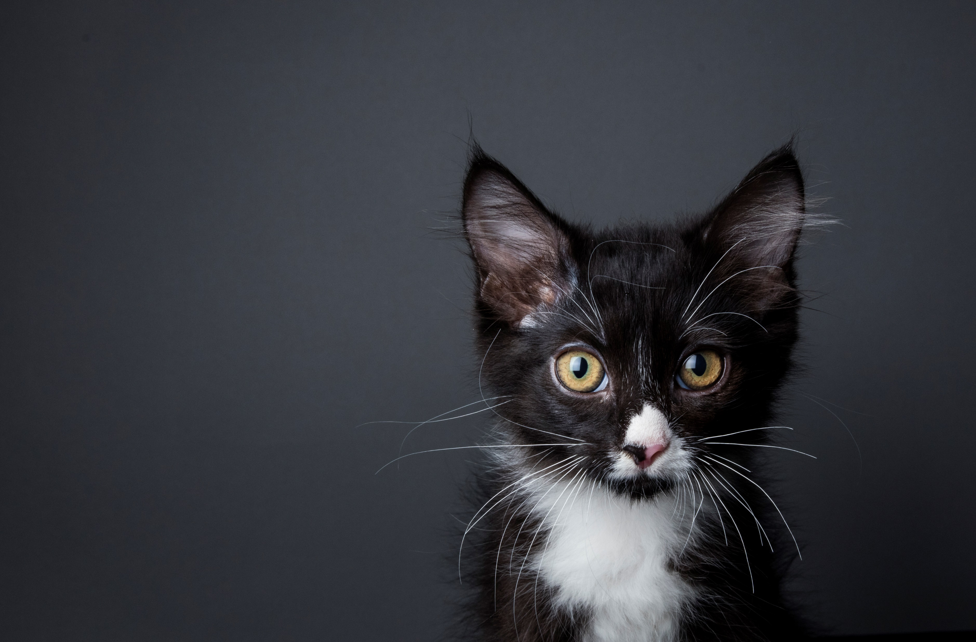
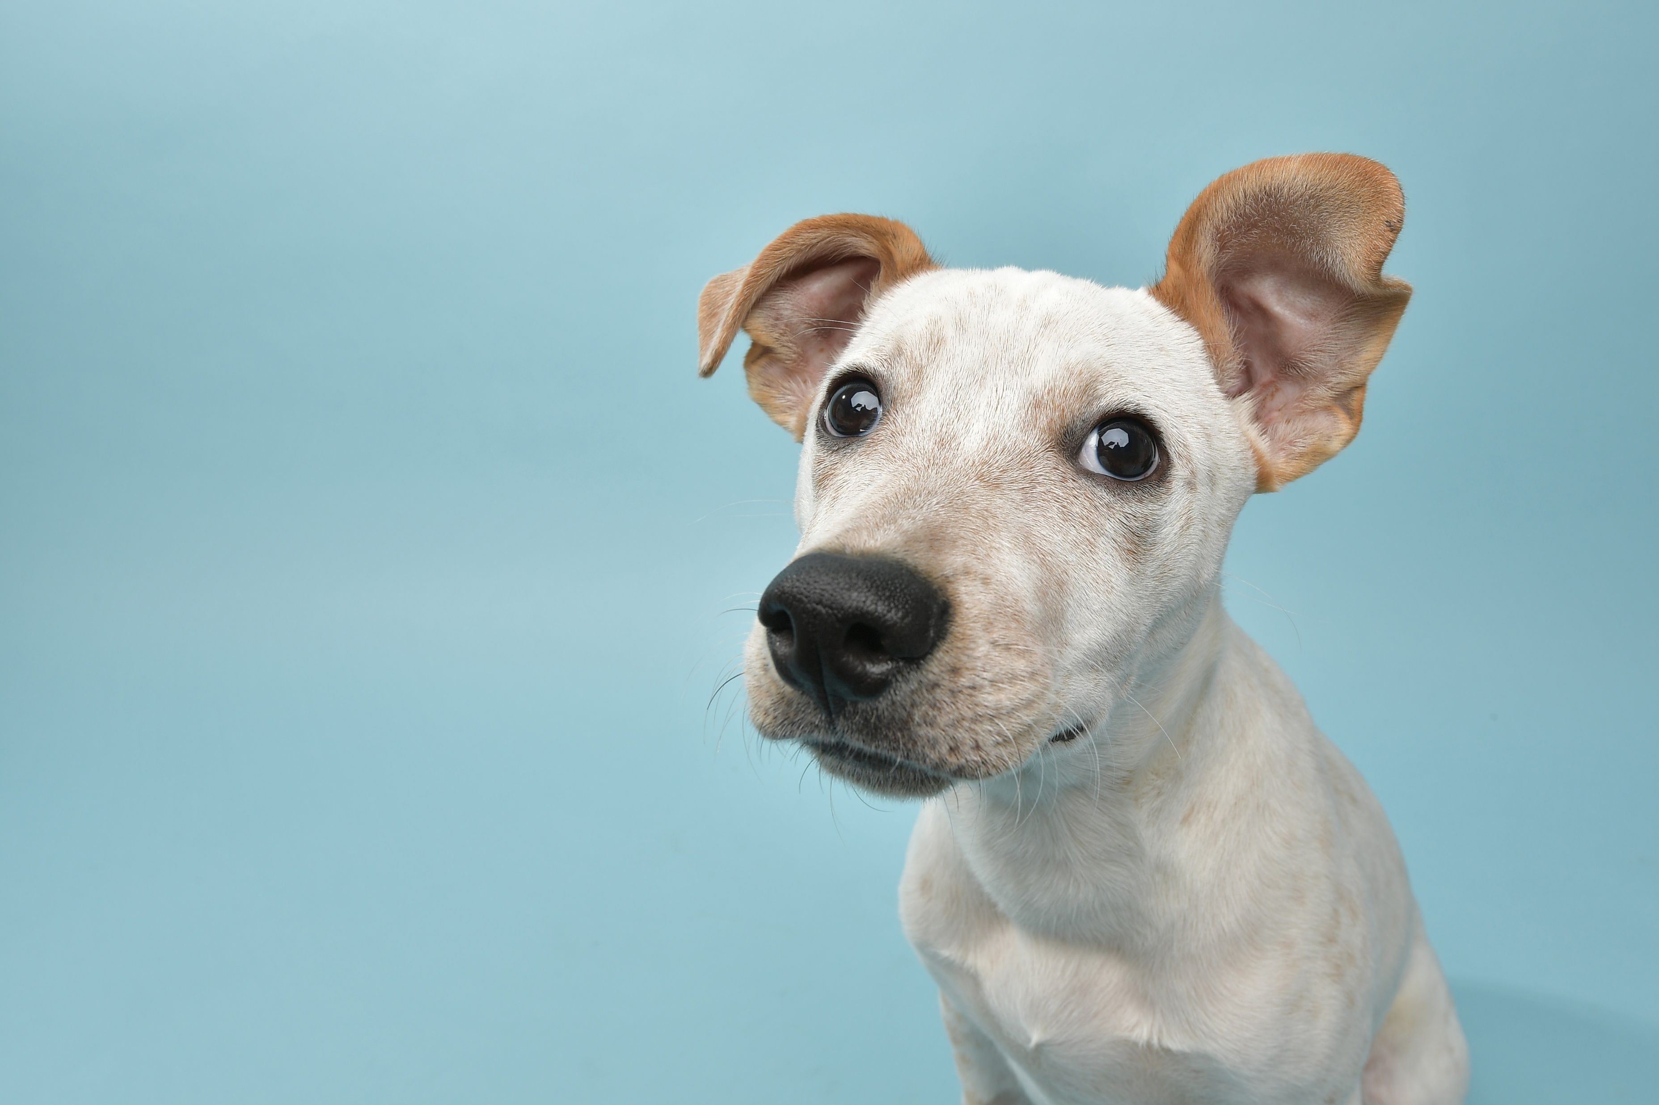
Topic for Debate
This house believes medical testing on animals should come to an end
Image courtesy of NIAID-RML
In pairs, work together to create For or Against arguments for the above statement.

Slide 4
Topic for Debate
This house believes we need One Medicine, so humans and animals benefit equally
Image courtesy of NIAID-RML
In pairs, work together to create
For and Against arguments for the above statement.

Slide 5
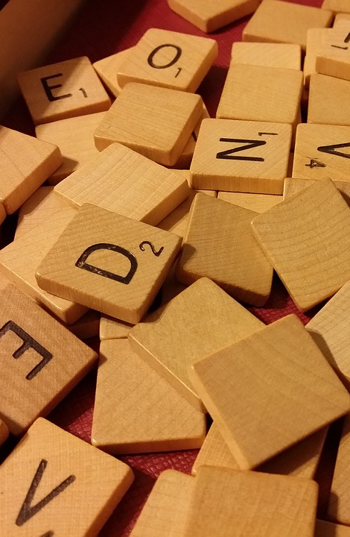
Some useful vocabulary
fact, fallacy, alternative, hypothetical, support, objective, alternative, conclusion, evidence, persuade, suffering, opinion, necessary, unnecessary, inconclusive, firstly, in addition, furthermore, on the other hand, secondly, in conclusion, on reflection, to sum up

Slide 6
Now you have created your arguments, in your pairs, you can start to debate!
Even if you are both have the same viewpoint, see how you can discuss this topic using all your awesome points, sensibly and respectfully

